Slide 1

LITT
Guide from OEO

Slide 2
Table of Contents
Click a link below to automatically jump to the corresponding section.
TOC
Necessary Tools for Running an Audit
Using Customer Search to Create a Client
Verification and Enrollment
Enrolling in a Program
Customer Reports
The Audit Process
Outreach/Points List
WA 10 Settings
Housing Items button
Health and Safety
Incidental Repairs Vs Health and Safety
General Heat Waste
(GHW) Measures
How To Upload Photos In The LITT System
Audit Documents Upload
AUDIT ERRORS
WORK ORDERS
WRF in LITT
Adding Funding Sources in LITT
Change Orders / Adding Additional Measures Post-Audit
QCI to Closeout
Locking the Job
1071 Report
Adding Group / Measures Cost in LITT
Add People
LITT Vendor Entry
Adding Funding Sources
Updating Libraries
Entering Inventory

Slide 3

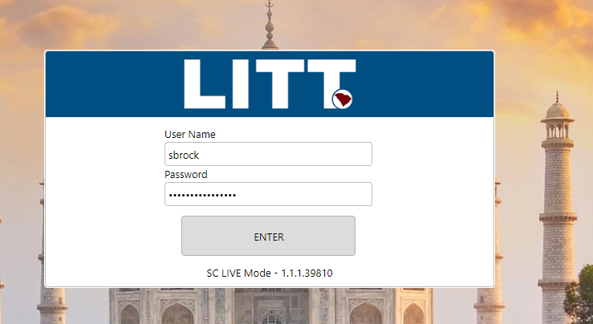
Live Log-On:

Slide 4

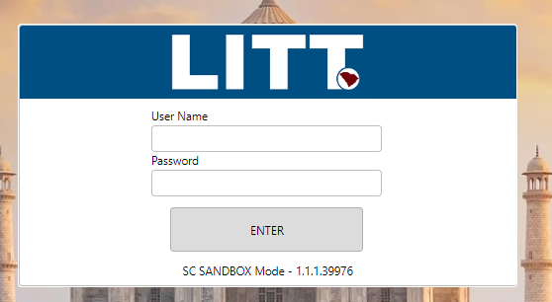
Sandbox Log-On:

Slide 5
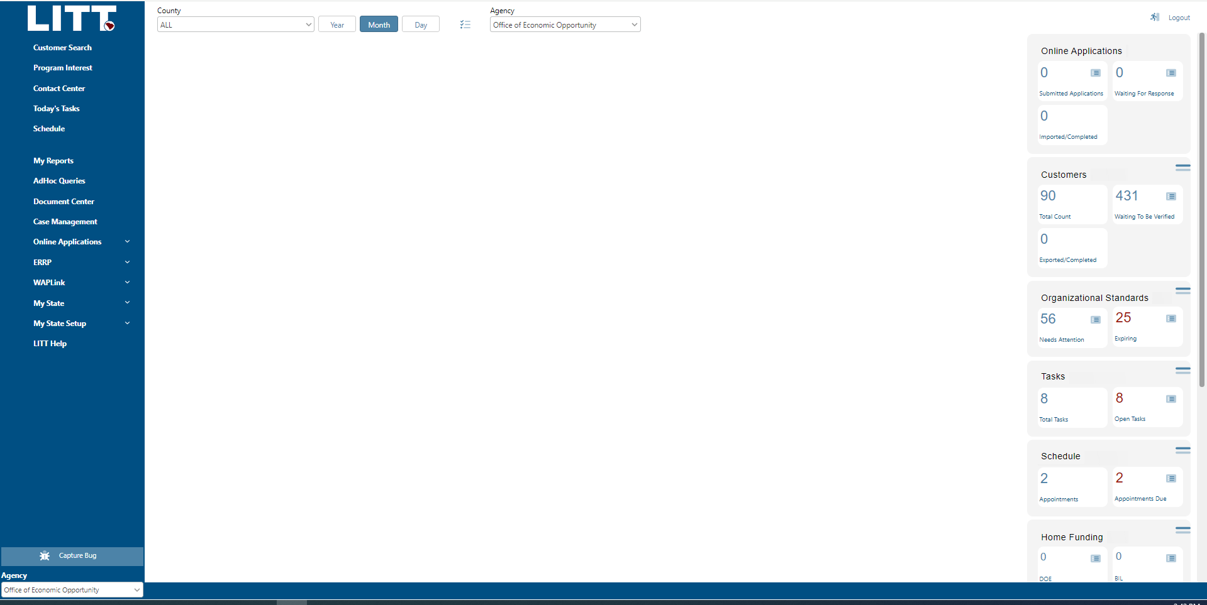
Log-On Screen
The first thing you see once you log in

Slide 6
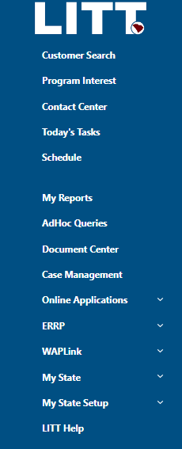
Necessary Tools for Running an Audit
Only Customer Search and WAPLink will be necessary for running an audit.

Slide 7
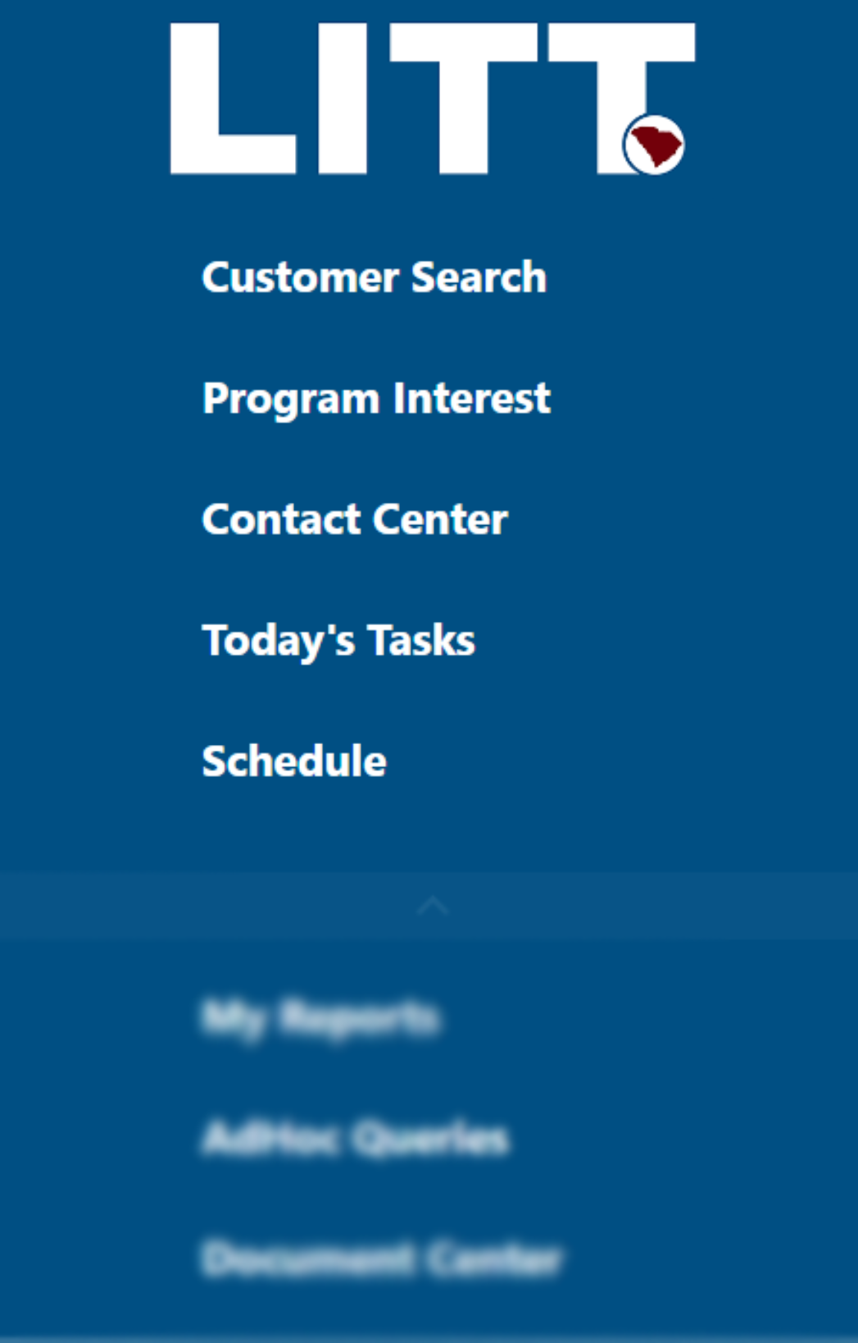
LEFT TOOLBAR OVERVIEW– Part 1
Customer Search
Find clients in the system
Program Interest
Intended for online applications, which are not yet functional
Contact Center
View emails sent through LITT, such as sent work orders, audits, and LITT Reports, send additional emails
Today’s Tasks
Assign tasks to contractors, auditors, staff
Schedule
Works with “Today’s Tasks” View timeline of tasks assigned.
x
not required

Slide 8

LEFT TOOLBAR– Part 2
My Reports
Reports generated by LITT will appear here.
AdHoc Queries
Create reports in LITT
Document Center
View and download Forms
Case Management
Will not be used until multiple programs are utilized through LITT.
Online Applications
Not functional
WAPLink
Manage clients’ needs specific to the WAPLink program
x
x

Slide 9
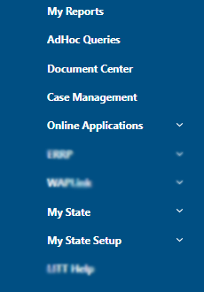
LEFT TOOLBAR– Part 3
My Agency/State
My Agency/State Setup
Your screen should display “My Agency” and “My Agency Setup.” These two settings will be used to change settings, add users, change fuel costs, etc.

Slide 10
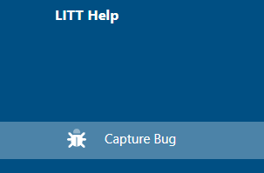

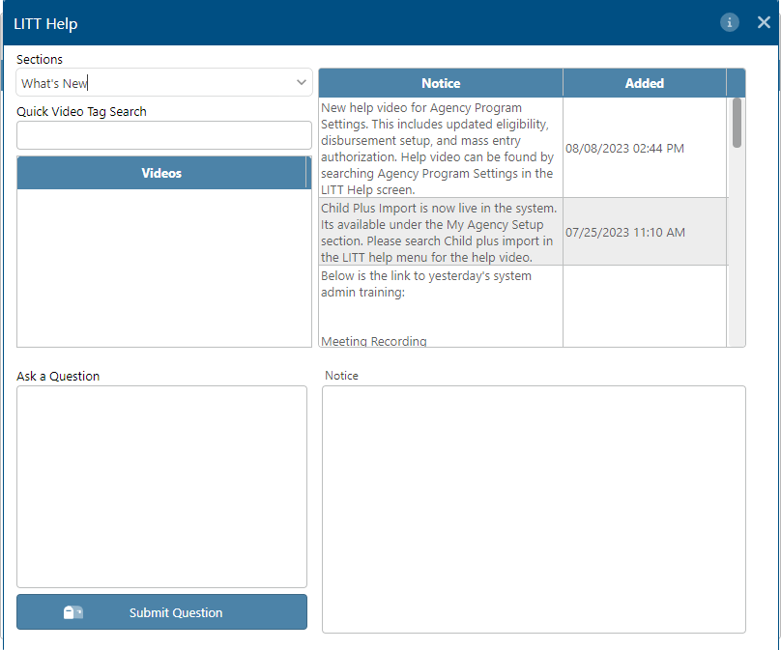
LEFT TOOLBAR– Part 3
LITT Help Videos
This selection will have videos and tutorials for various processes, such as creating a client and running reports.
As well, the bottom left corner of the window allows you to ask the SC LITT tech team a question that they will return by email.
This functionality will be useful once live, but until April please direct questions to OEO to let LITT’s programming team focus on updates.

Slide 11
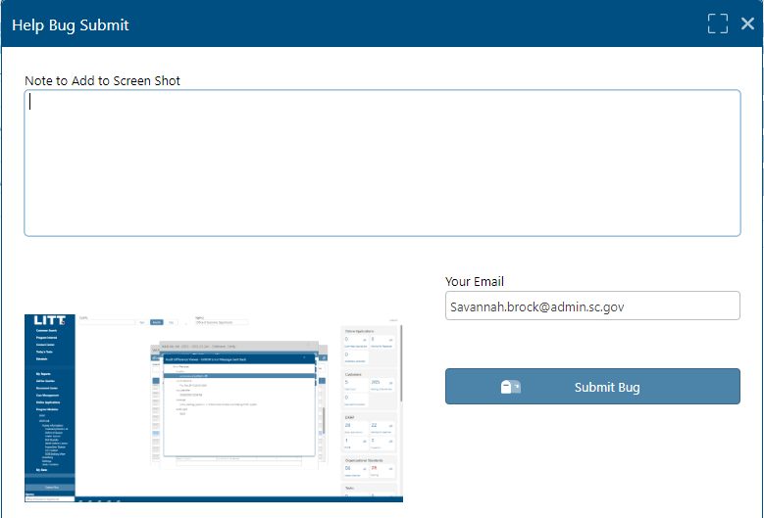
LEFT TOOLBAR– Part 4
Bug Reports
When and if you run into a bug, you can click on “Capture Bug” on the bottom left toolbar. A window will pop up titled “Help Bug Submit.”
Explain what you clicked on or entered just before the bug occurred in the “Note to Add to Screen Shot” box.
Then click Submit Bug in the bottom right-hand corner of the window.
This helps the programmers find and fix as many bugs as possible before we switch.

Slide 12
Using Customer Search to Create a Client
LITT requires the user to search for the client’s name before entering it in the system.
This is done to reduce the prevalence of duplicates.

Slide 13
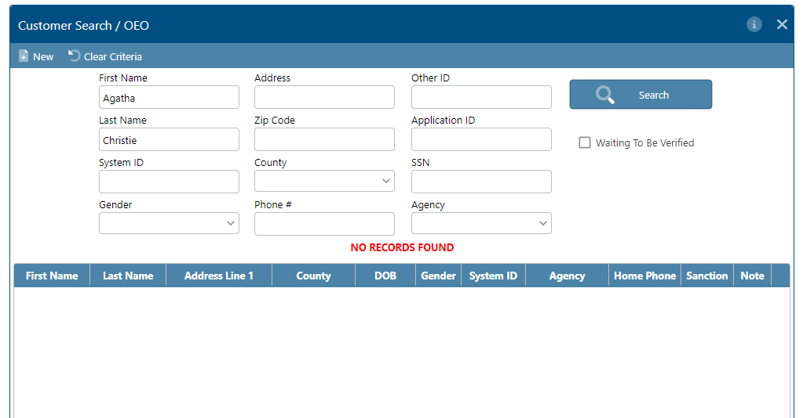

Use Customer Search to Create a Client
Search the name of your test client.
If your client has already been entered in the system, they will appear under the blue bar.
For training purposes, you are creating a new client, so they will not be in the system.
So, it should say “no records found” in red.
Then, click “New.”

Slide 14
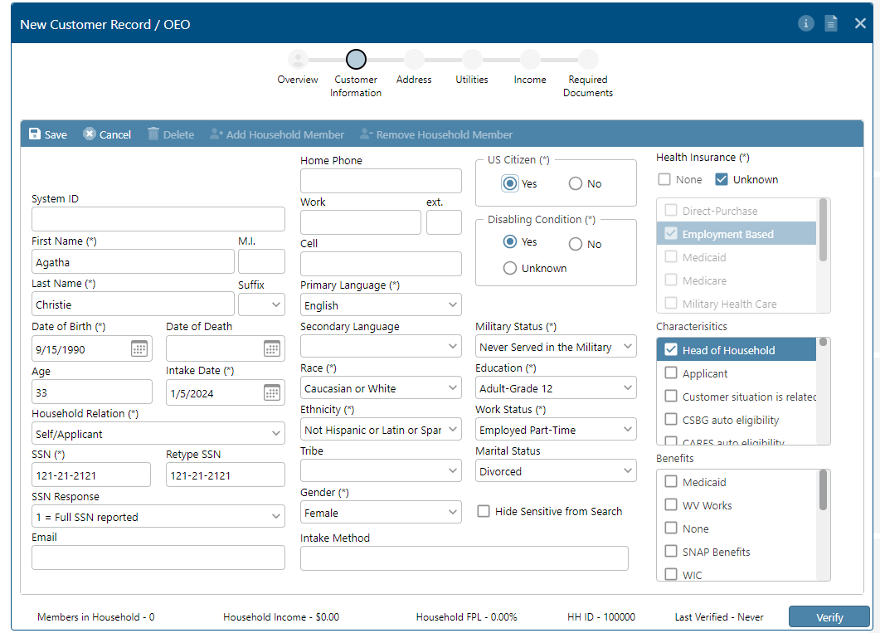

New Customer Record Screen
Required fields are highlighted with an asterisk.
The required items in this screen are the minimum needed to save the record.
1.
Save as often as possible as you complete this record.
Information may be changed or completed later as long as it is saved the first time.
2.

Slide 15
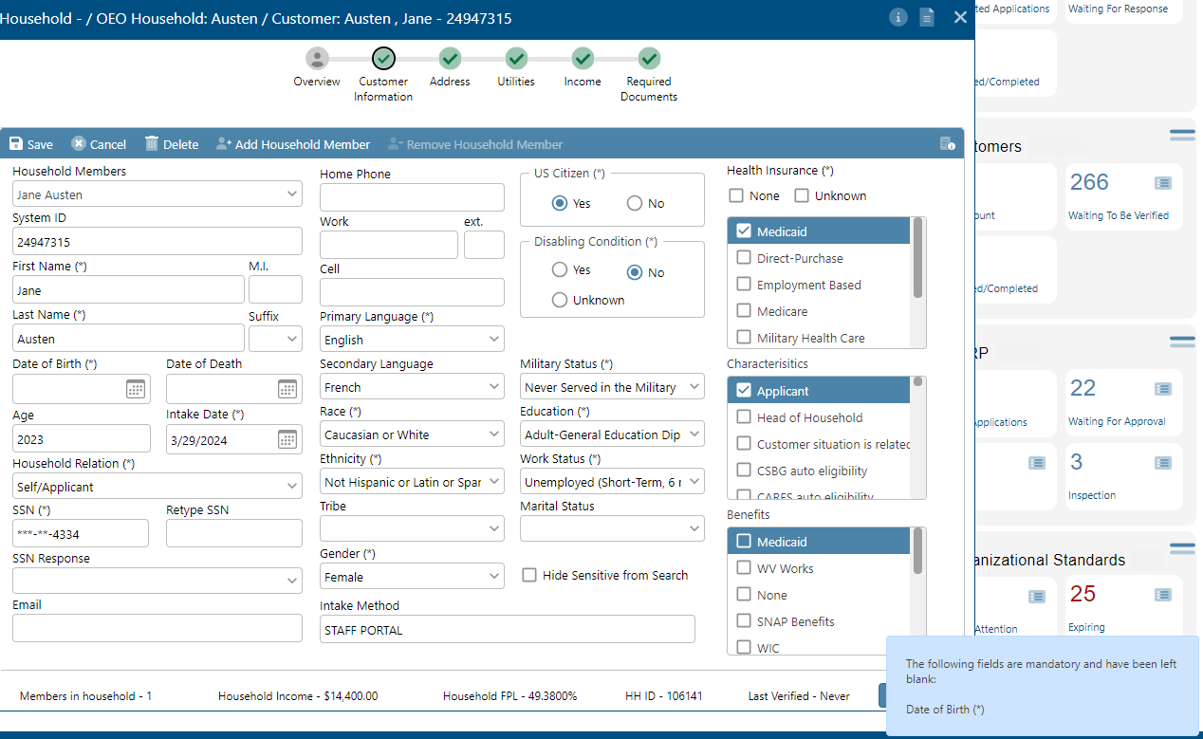
Saving a New Customer Record
If a required field is not completed and you attempt to save the record,
an error message will be returned in the bottom right corner of your screen.
After this point, the client file can be retrieved and updated with any new information received at a later date.

Slide 16
Verification and Enrollment
Before we progress with the file….
In order to appear in the Audit queue and begin the audit, the client must be Verified in LITT and they must be Enrolled in Weatherization in LITT.
Verifying and Enrolling a client requires completing all fields with asterisks, the Income screen to be completed, and the ID and Income Documentation uploaded in the Required Documents page.
These processes will be discussed more in depth after slide

Slide 17
Add Household Member
The initial Customer Information screen only collects information about the primary applicant.
To include other members of the household in the customer record, select “Add Household Member”.
Then, complete the customer record screen with the information from your secondary household member.
Creating a second member will be particularly important when there is more than one source of income.

Slide 18

Customer Record Navigation
Click on each little gray circle to navigate to and complete that section of the file. Once it has been completed, it will show a green checkmark.

Slide 19
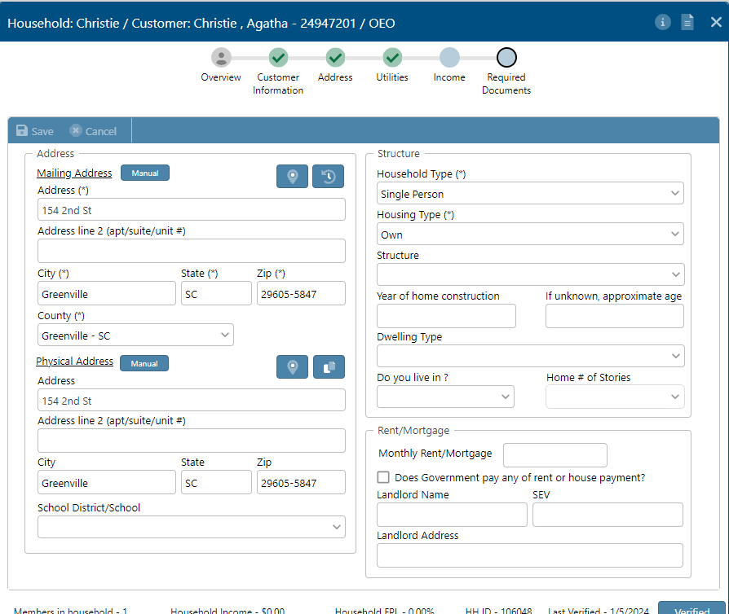
Address
This button copies the Mailing Address so it does not need to be typed twice.

Slide 20
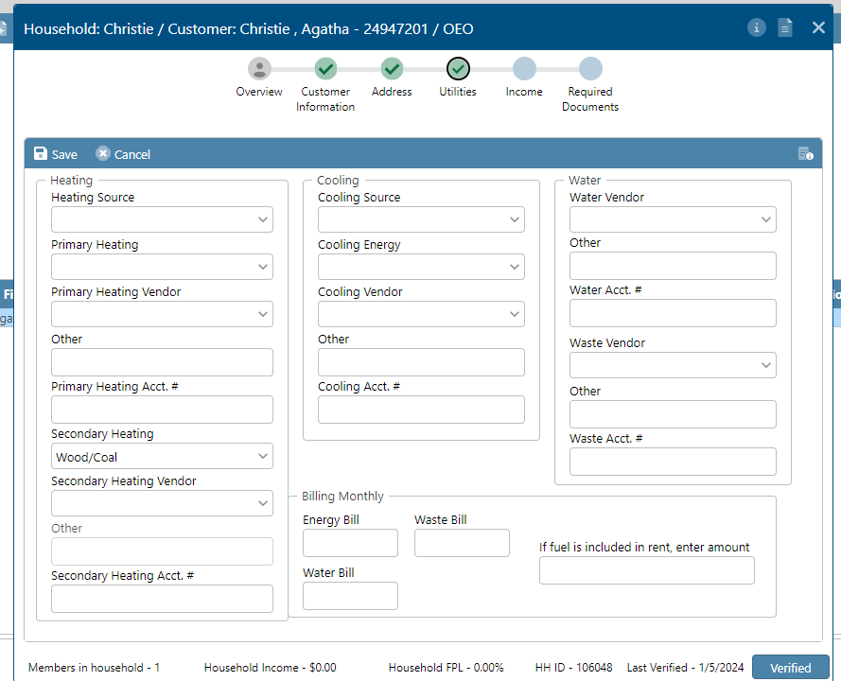
Utilities
The bottom right corner is where you will enter information about the client’s energy bill.

Slide 21
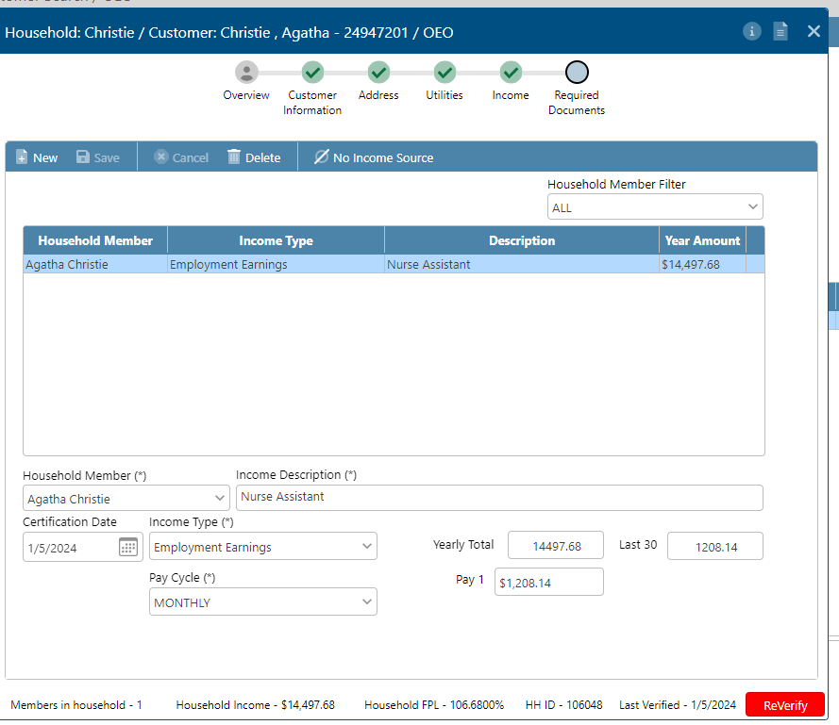





Income Screen
Save
Select “New” to add an income source
Repeat steps 1-4 to add additional income sources.
Select which household member receives the income, type of income, and description of income (usually job title)
Select Pay Cycle and complete information to right. Yearly Total and Last 30 will automatically update based on Pay 1.

Slide 22
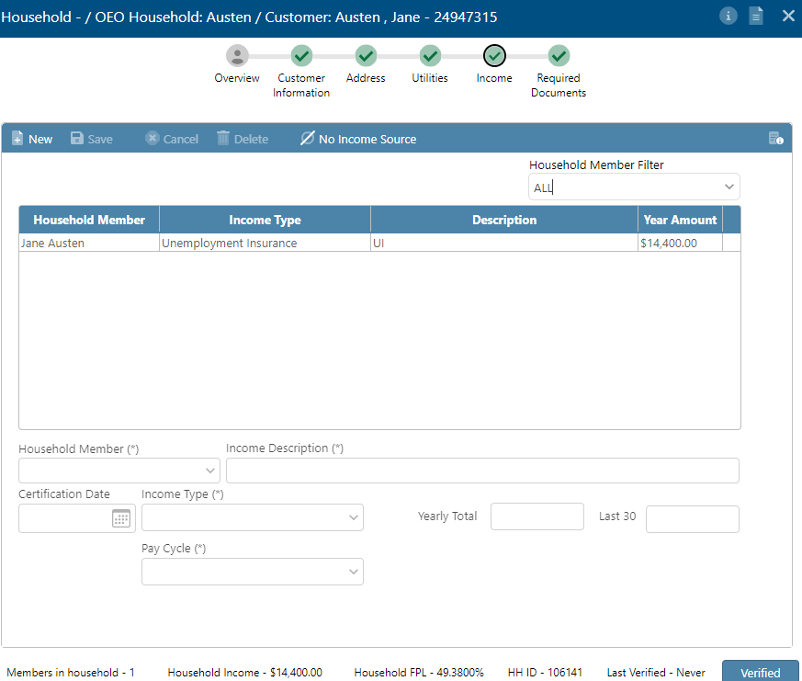


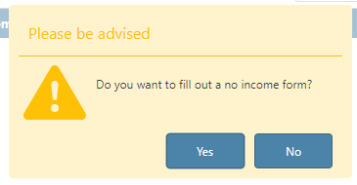
No Income Source
If one of the household members does not have an income, you may indicate this by clicking on the Household Member Filter Drop-Down, selecting the client’s name, and then clicking “No Income Source” on the middle blue bar.
It will ask if you’d like to fill out a no income form.
Answer “No” if you would like to complete, scan and upload a paper copy of the Zero Income Form. Answer “Yes” if you will use the zero-income functionality in LITT.

Slide 23
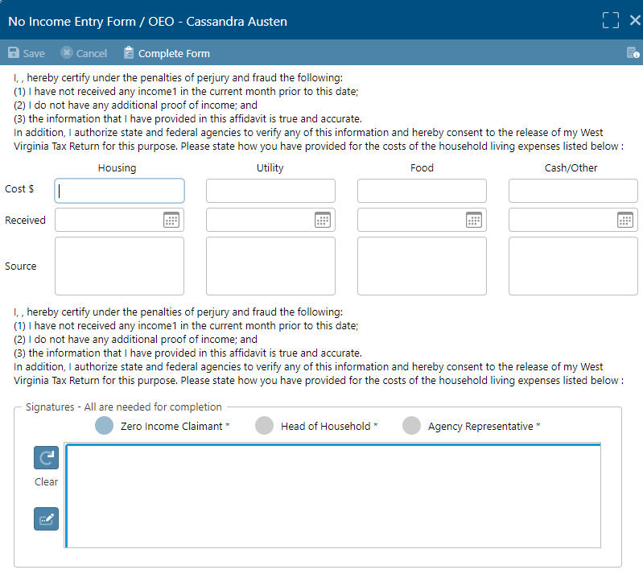
No Income Form
Once you click on “Yes” A screen titled “No Income Entry Form” will appear.
If you have a tablet or touch screen computer, the signature fields can be signed.
once “complete form” is selected, a .pdf will be created that is automatically uploaded to the client file on the Required Documents tab.
The .pdf file will be sent to My Reports on the left taskbar as well, so that you may download the form or print it.

Slide 24
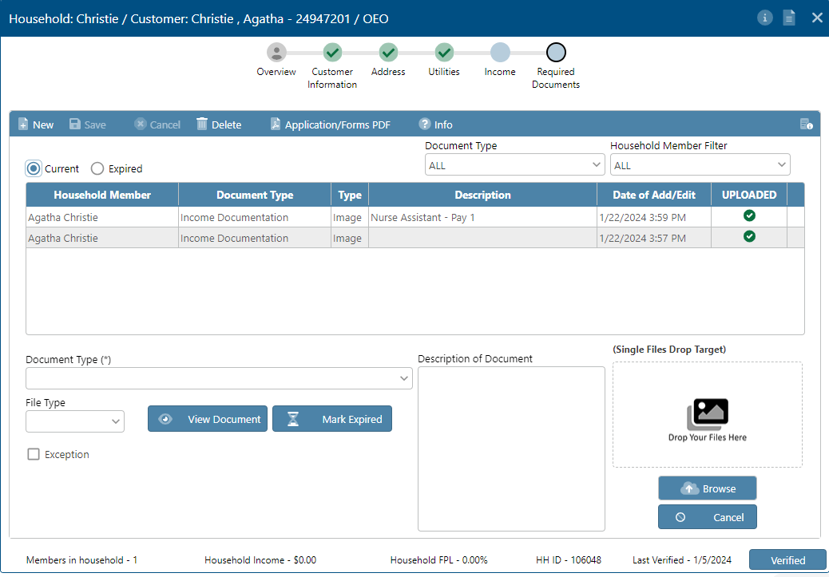
Required Documents
Select New to upload a document.
Select the Document Type from the drop-down (ID, Verification of income).
Feel free to add a brief description of the document.
Select Browse to open your computer files and selected a document to upload. You also may drag a file from its location on the computer into the target.
If you notice that the document you have been given is expired, you can select “Mark Expired” to keep the document on the record until up-to-date information is provided.
Click Save.
Finally, VERIFY your file at the bottom right corner.

Slide 25
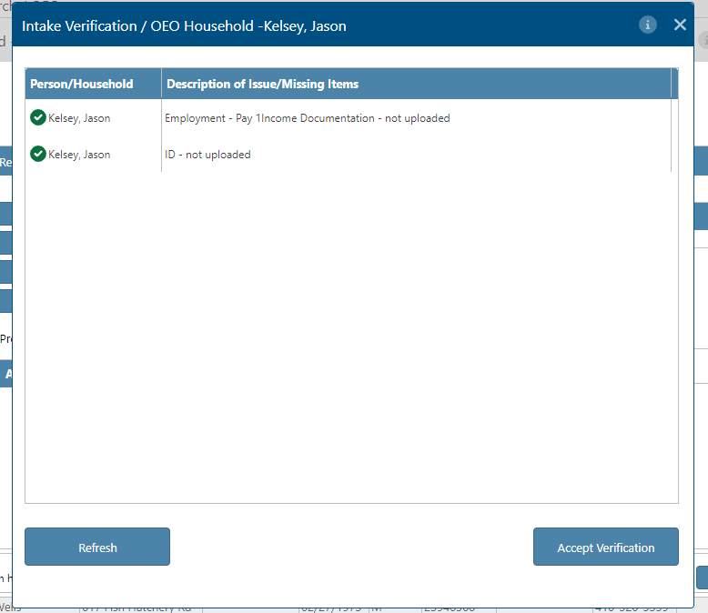
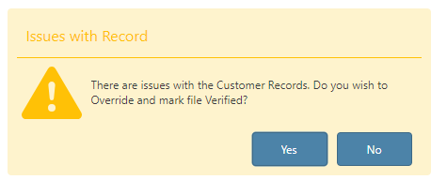
Verifying a Client
The “Verification” system is intended to catch errors in a client file. It will tell you if fields are incomplete or nonsensical. It is best to verify at the end of entering a client’s information.
A client must be “verified” before they can be enrolled in a program.
Once enrolled in a program, their name will display on the WAPLink Home Queue and the file will be able to be audited.
Verification can be overridden. However, a verified client without minimum fields completed cannot be enrolled in a program.

Slide 26
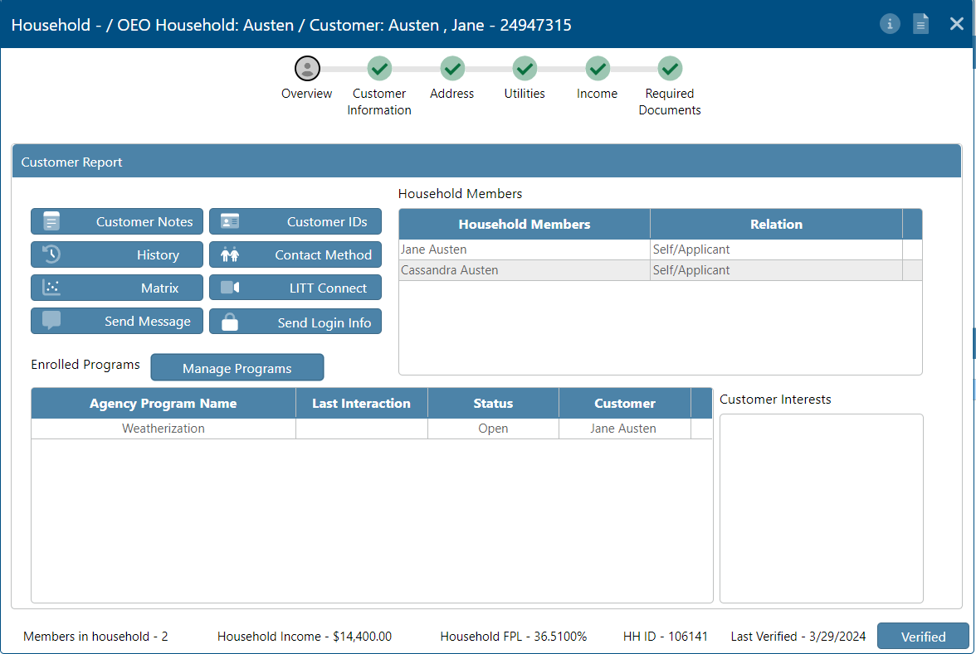
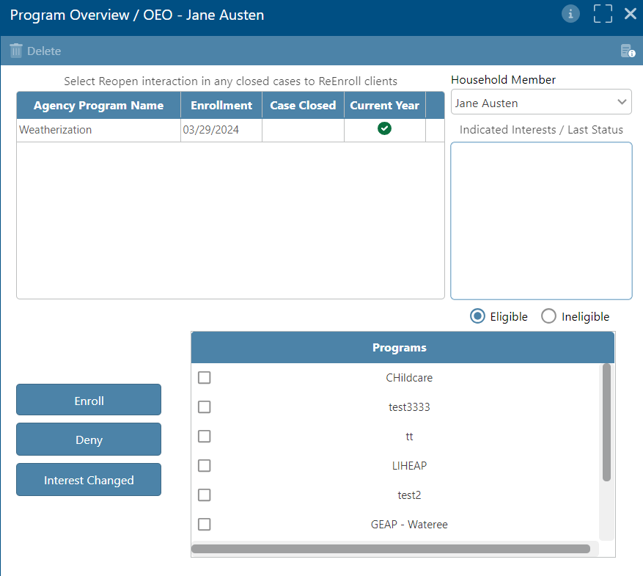
Enrolling in a Program
Note that a client cannot be audited without being enrolled in Weatherization.
On the Overview Screen, click on Manage Programs. A screen will pop up titled “Program Overview.”

Slide 27
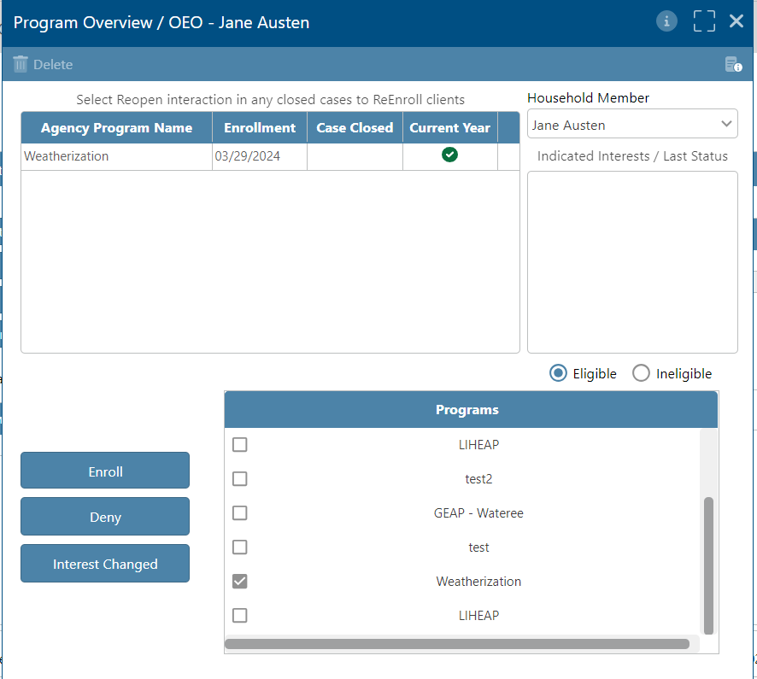
Enrolling in a Program
On the “Program Overview” screen, you will be able to select from a list of programs. You may need to scroll down to find weatherization.
Click the box that says ‘“Weatherization” and click “Enroll.” If the client is ineligible due to income, it will not allow you to enroll on this screen.
You can check if it worked on the client’s Customer Search Overview Screen.

Slide 28
Enrolling in a Program
You can check if it worked on the client’s Customer Search Overview Screen.
If enrollment was successful, it will show “Weatherization” in the highlighted box.

Slide 29
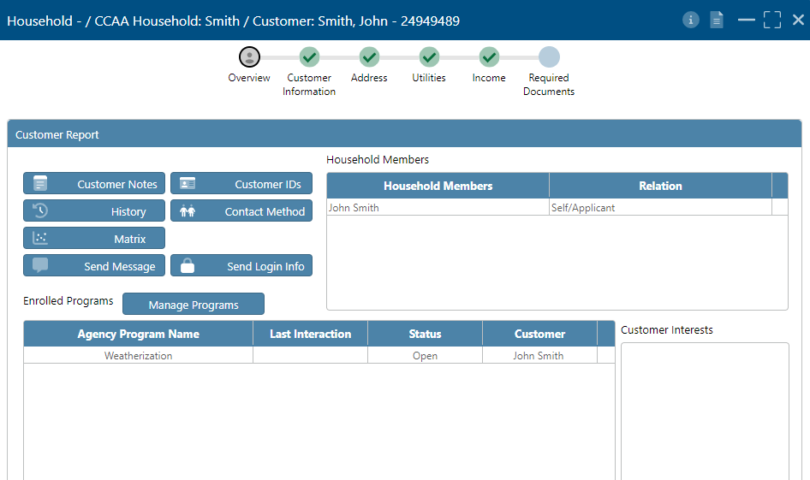
Enrolling Clients who qualified under SSI or TANF
Clients may qualify for Weatherization, regardless of income, if they or a household member is enrolled in either TANF or SSI or received benefits from TANF or SSI in the 12-month period proceeding the determination of eligibility for Weatherization.
To enter a client with TANF or SSI benefits into LITT; and make sure that their priority points are calculated correctly and that their eligibility to enroll is not restricted by income, you must enter “WX-other govt. benefits” as a characteristic in LITT.
Open the customer Search/entry screen as you would normally. The characteristics are on the Customer Information screen.

Slide 30
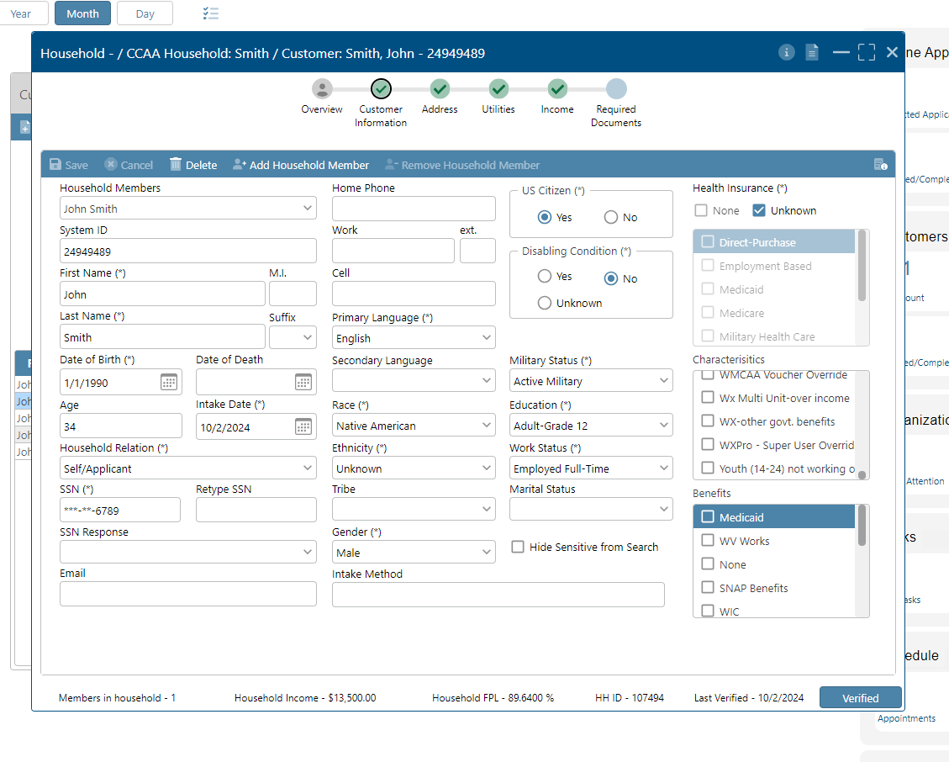
Finding “WX-other govt. benefits”
This process is best completed at the initial customer entry phase. If it is discovered at a later date that the customer qualifies for Weatherization because of TANF or SSI benefits it can be entered and the customer re-verified. I.e…The customer was initially ruled ineligible for being above the income level allowed, but then states that a household member is receiving TANF or SSI or has received TANF or SSI in the proceeding 12-month period.
On the Customer Information screen there is a box in the middle on the right-hand side labeled Characteristics. If you scroll to the bottom, you will find “WX- other Govt. benefits” as an option. Check this box and complete a zero-income form; following the instructions on page 58 of SC Policy and Procedures manual.

Slide 31
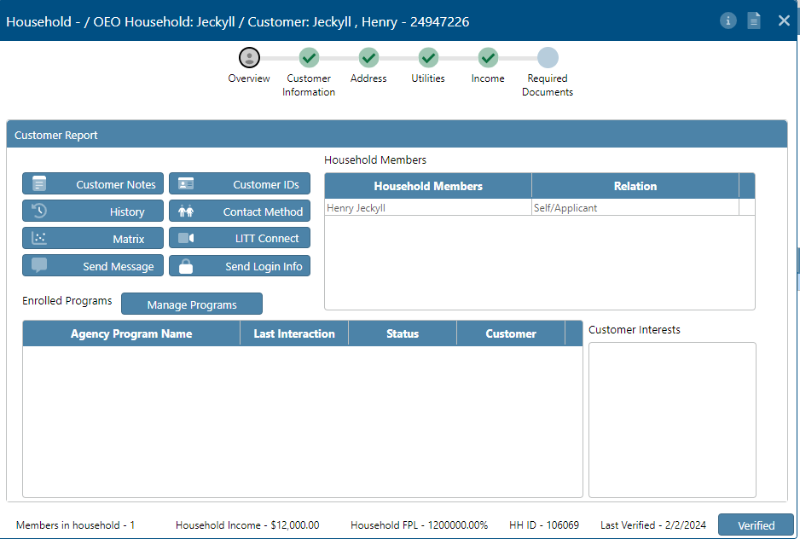
Customer Reports
To print the entered data about a client, you can run a customer report.
Search for a client on the Customer Search function. Make sure you are on the “Overview” screen once you find your client.
Then, Click the Customer Report Button.

Slide 32
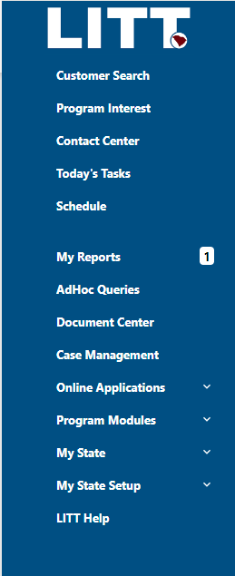
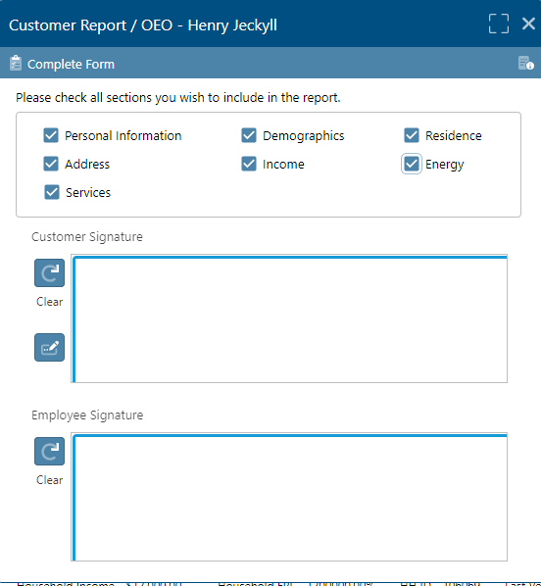
Customer Reports
The Customer Report window will open.
Select the relevant information and click Complete Form.
When the report is finished, it will appear under My Reports in the toolbar.

Slide 33
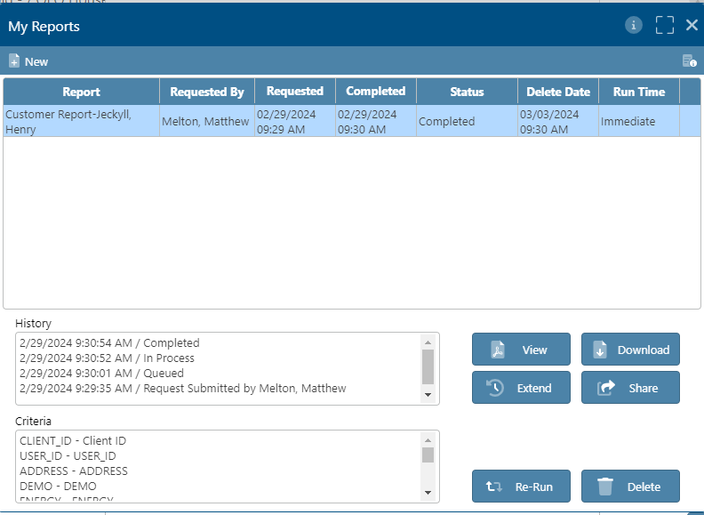
Customer Reports
Click the View button.
Report will display...

Slide 34
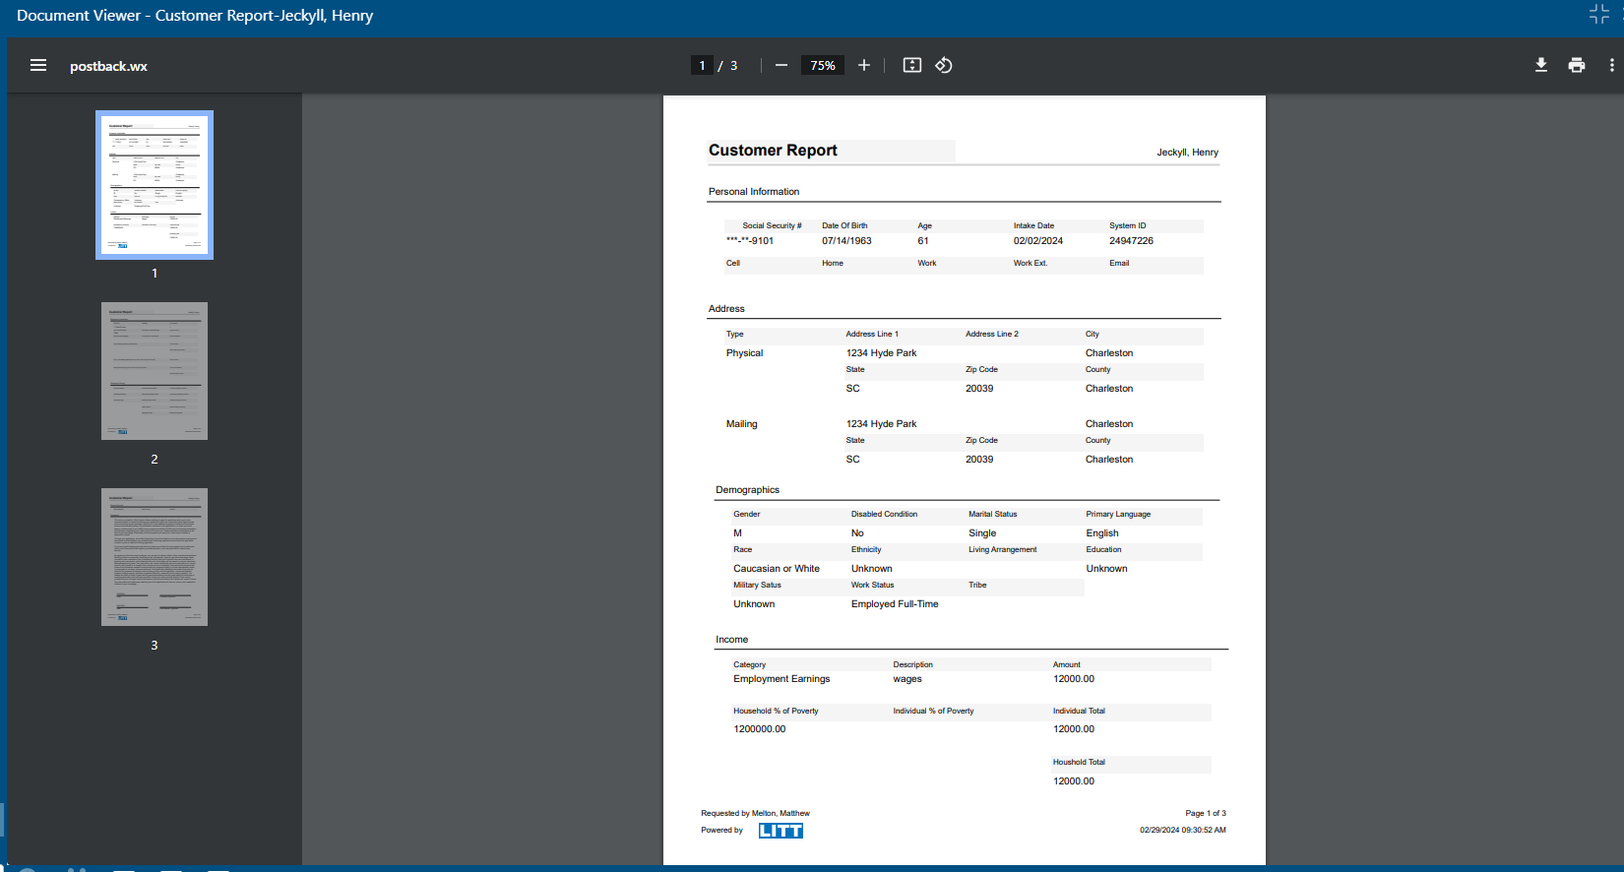

Slide 35
The Audit Process

Slide 36
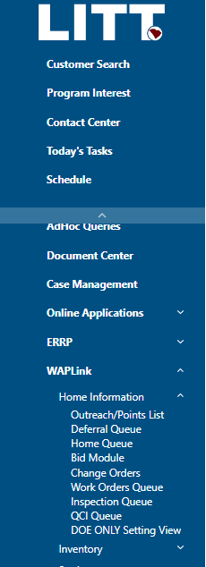
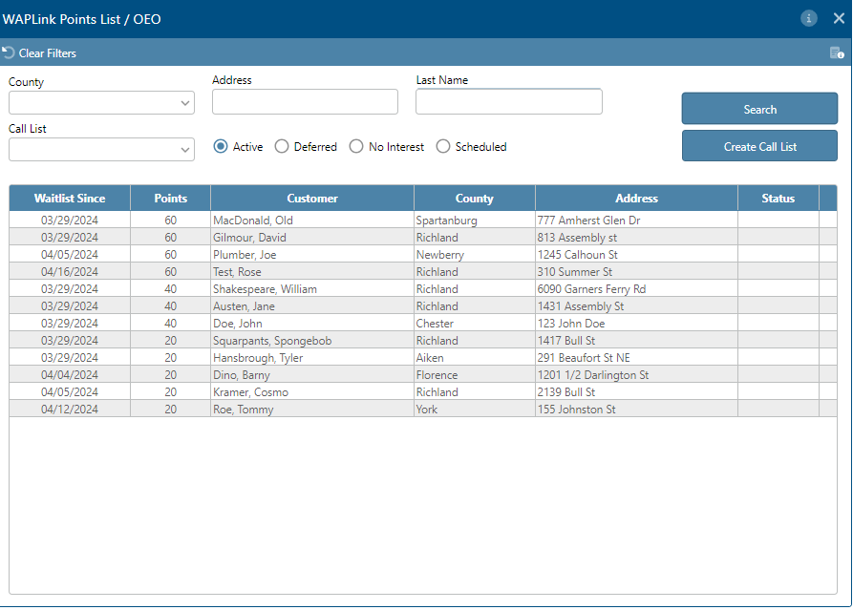
Outreach/Points List
Once your client has been enrolled, they will show up on the Outreach/Points List Screen, sorted by the highest priority client to the lowest priority.
You may need to click “Search” to make all clients appear. You may also search a specific client.
Click the client’s name to open the Call List window.

Slide 37
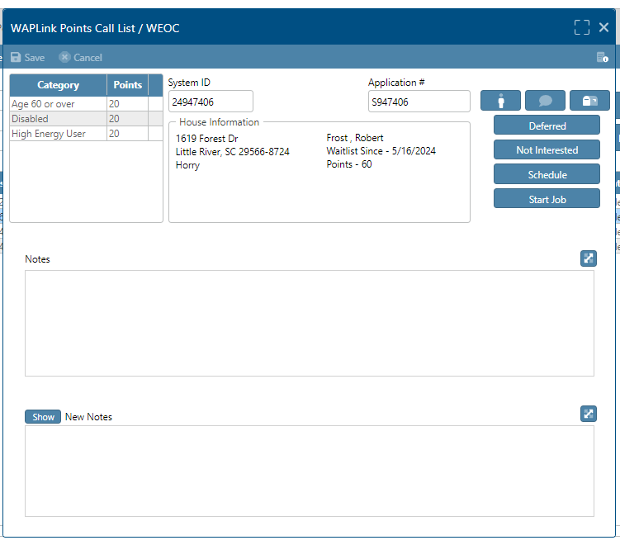
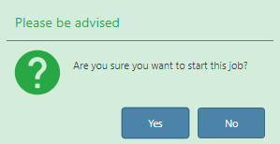
Outreach/Points List
Once the “Points Call List” screen is open, click “Start Job.”
A green box will appear asking if you are sure. Click yes.
It should take you immediately to the audit screen.
If you’d like to use the scheduling module, there is an alternative function. You may click “Schedule” and schedule a date and time for the audit. After which point it will appear in the WAPLink Home Queue.
However, the scheduling function is not required.

Slide 38
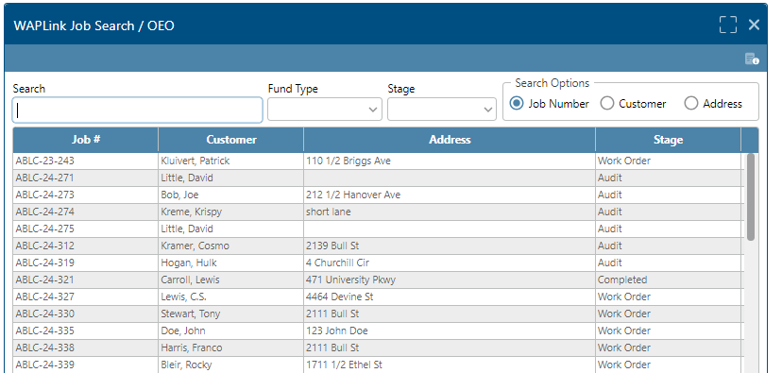
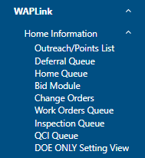
Outreach/Points List
If the screen does not immediately take you to the audit, you can still access the audit.
On the left toolbar select:
WAPLink
Then Home Information
Then Home Queue
That will make the “WAPLink Job Search” window pop up (above)

Slide 39
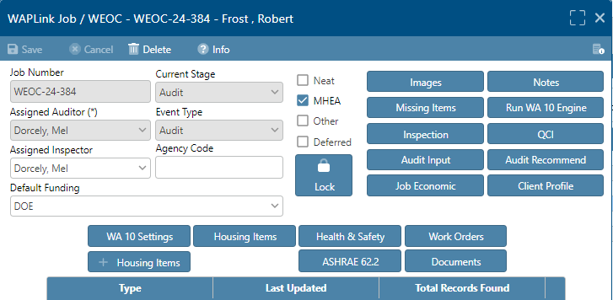
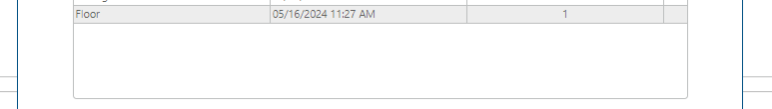
Click the result and it will bring you to the audit window.
On the audit window, make sure you select “Assigned Auditor” with your name and select what type of audit you’ll perform from the check boxes.
New features include
Agency Code
Use this field to give the Audit a different job number, for example, if your Agency has a job naming system
Default Funding
Select the funding source you will most likely use. This can be changed at any time and does not restrict you from
Client Profile
Return to Customer Search
Job Economic
Quick run-down of costs– separate from Cost Center

Slide 40
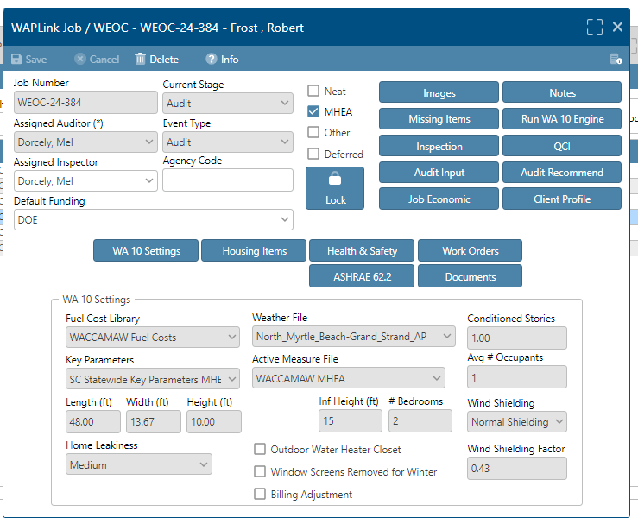
WA 10 Settings
On this screen, you will need to enter the WA 10 Settings that will influence the audit. Select the appropriate Fuel Cost Library, Weather File, Key Parameters, and Active Measure File from the drop-down boxes.
You will also need to manually enter the Conditioned Stories, Average Number of Occupants, Floor Area of the dwelling, Infiltration Height, and # of Bedrooms.
After saving the information on this screen, you are ready to enter the details of the home that were captured on the 501 Form.

Slide 41
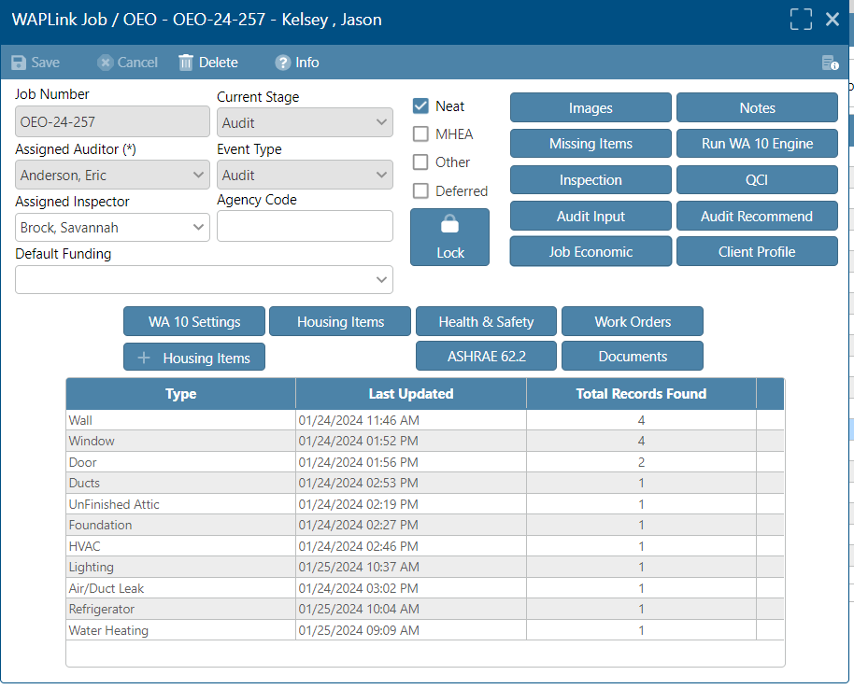
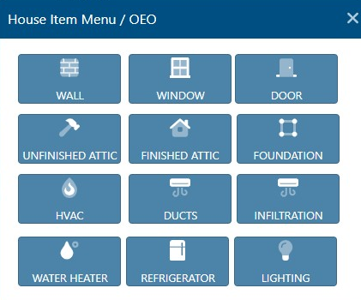
Start by clicking the Housing Items button on this screen.
Next, click the + Housing Items button.
A new window will pop up listing different aspects of the home (Walls, Windows, etc.) you will need to enter information for to conduct an energy audit of the home.
Click the WALL button.

Slide 42
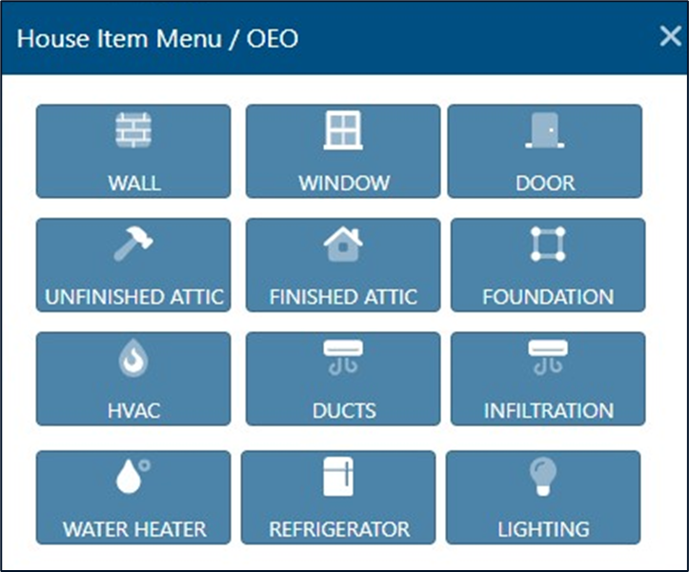
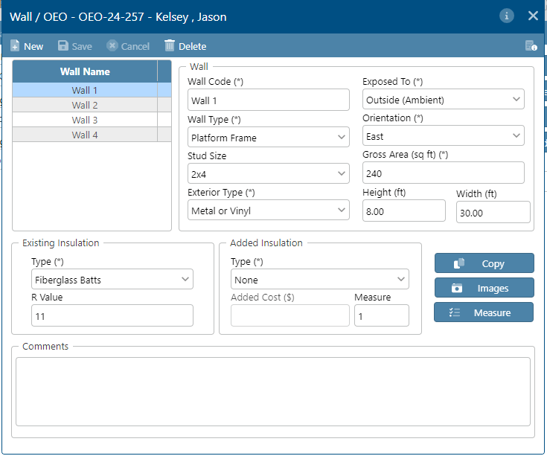
WALLS
Click on the New button on the top left side.
Enter the Wall Code (name), Wall Type, Stud Size, Exterior Type, what the wall is Exposed To, the Orientation and the Gross Area (sq. ft.) of the wall using the drop-down box next to each field. Enter the Height and the Width for each Wall.
Next, using the Existing Insulation section, if the wall has insulation indicate the type and R Value. If adding Insulation, enter the Type of insulation and the added cost. You can also give it a Measure Number.
If there are any special circumstances notate them in the Comment space provided.
Hit the Save button.
Repeat for each wall in the dwelling.

Slide 43
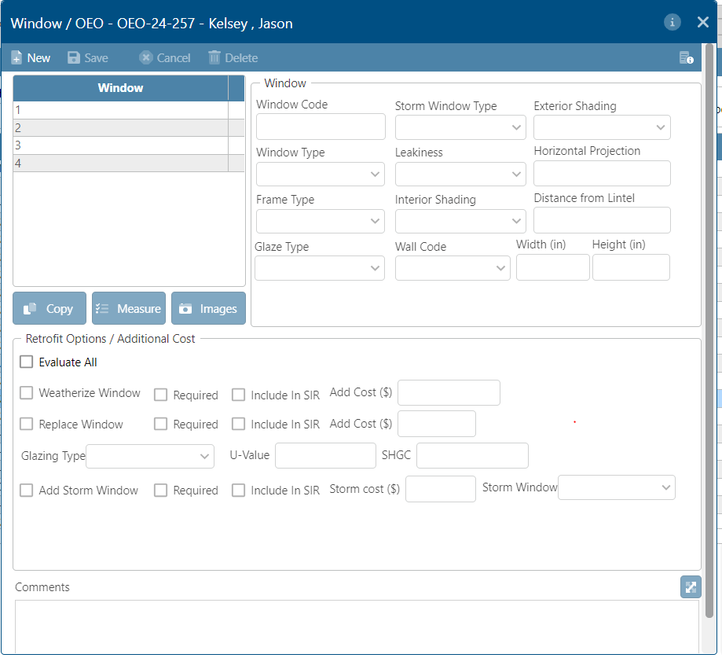
WINDOWS
Click on the WINDOW Tab of the +Housing Items Menu.
Click on the New button on the top left side.
Using the drop-down box next to each field, enter the Window Code (name), Window Type, Frame Type, Glazing Type, Storm Window Type, Leakiness, Interior Shading Type, wall code, Exterior Shading, Horizontal Projection of Awning, and the distance from Lintel. Enter the Size (Width and Height) of the window.
From the Retrofit Options / Additional Cost Section, choose an option for the retrofitting of the window. Evaluate All, Weatherize Window, Replace Window, and Add Storm Window are your Options. Select the Glazing type, the U-Value, the SHGC and add the Storm Window Type.
If ”Evaluate All” is chosen, LITT will evaluate each measure and based upon the cost effectiveness will determine the best measure (if any). The measure cost for the four measures will be pulled from the Setup Library/Library Measures that has been previously completed. Any additional cost per window for the measures should be added in the Add Cost ($) field.

Slide 44
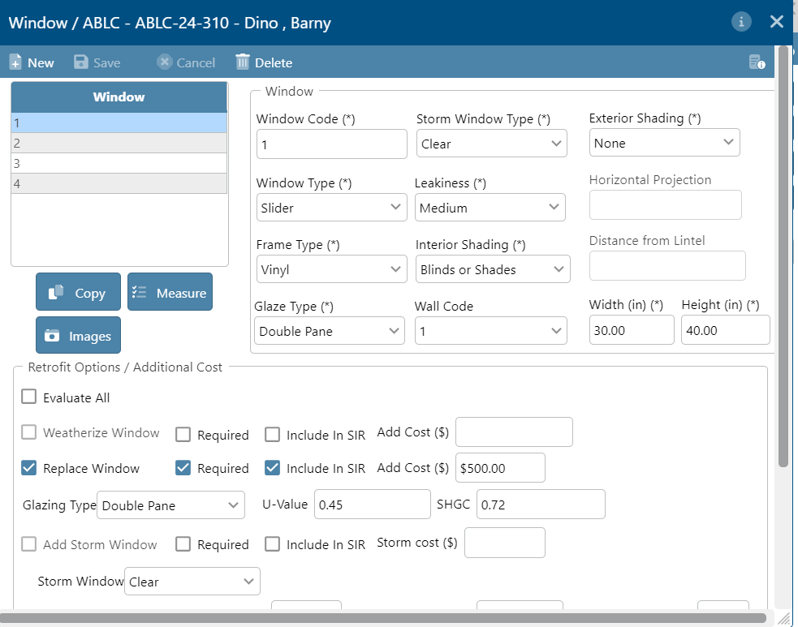
WINDOW RETROFITS
Remember, if you indicate a replacement window is required, it will appear on the audit regardless of its SIR.
The ‘Include in SIR’ box will cause the window replacement to impact the total SIR.

Slide 45
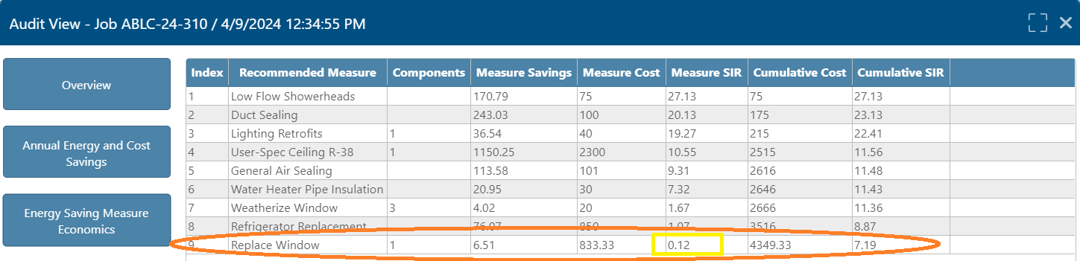
WINDOW RETROFITS
This is a screenshot of the work order, which will be explained in further training.
Notice the SIR is below both 1.0 and 0.5. The audit would need to be rerun with the required box unchecked and the window would need to be installed as an itemized Health and Safety Measure.

Slide 46
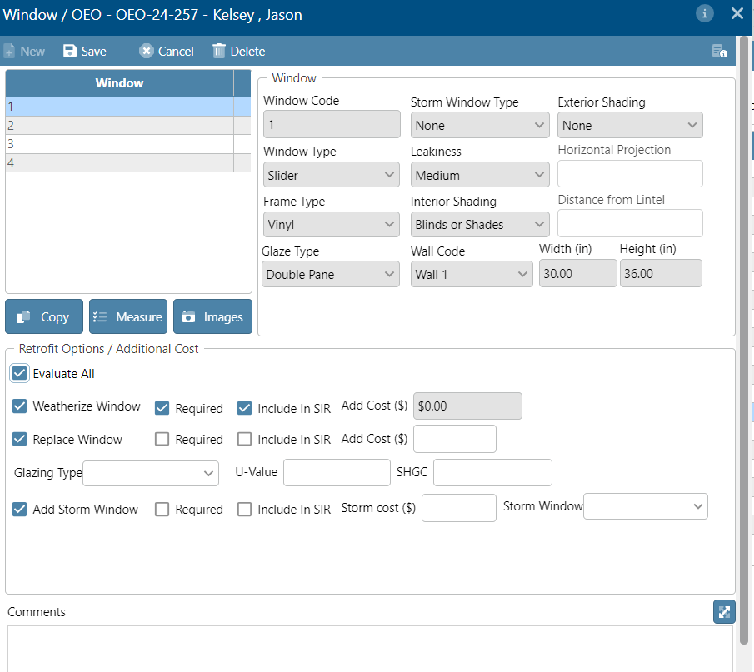
WINDOW RETROFITS
Unless you have a specific reason to not do so (which you should document in the comment box) , select ‘Evaluate All.’
If replacement windows do not come up as an ECM, they can be added as a Health and Safety Measure.

Slide 47
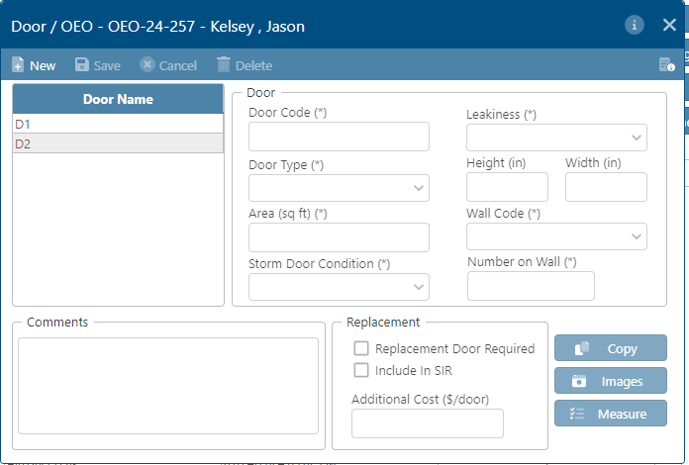
DOORS
Click on the New button on the top left side.
Enter the Door Code (name), and the Door Type using the drop-down box. Next, enter the Area of the Door (sq. ft), Storm Door Condition, and Leakiness. Enter the Height and Width of the door. Enter the Wall Code this Door corresponds to. Enter how many doors are on the corresponding wall.
In the Replacement section, check the box that asks, “ Include in SIR.” Enter any additional costs related to the replacement door in the Additional Cost ($/door) field.

Slide 48
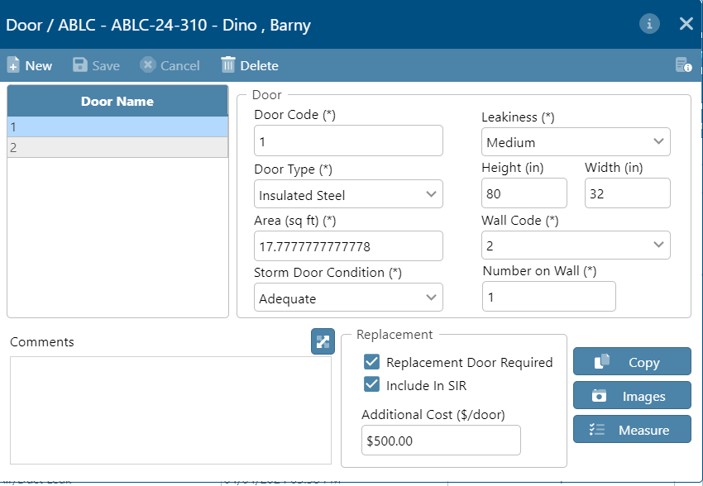
DOOR RETROFITS
Like with Windows:
If you indicate a replacement door is required, it will appear on the audit regardless of the SIR. The ‘Include in SIR’ box will cause the door replacement to impact the total SIR.

Slide 49

This is a screenshot of the work order, which will be explained in further training.
DOOR RETROFITS
Notice the SIR is below both 1.0 and 0.5. The audit would need to be rerun with the required box unchecked and the door would need to be installed as an itemized Health and Safety Measure.

Slide 50

UNFINISHED ATTIC
Click on the New button on the top left side.
Give it an Attic Code (number), using the drop-down box, enter the Attic Type (Cathedral or flat, or Floored, and Unfloored). Joist Spacing (in), Area (sq. ft.), and Roof Color.
If there is existing insulation go to the Existing Insulation section, using the drop-down box indicate the type of insulation (Blown Cellulose, Blown Fiberglass, Rockwool, Fiberglass Batts, or Other) and the recorded depth (in.).
If any insulation is to be added, go to the Added Insulation section, enter a Measure Number and using the drop-down box, enter the Type (Blown Cellulose or Blown Fiberglass). Enter the appropriate data into the Added R Value, Max Depth (in), and Additional Cost fields. If Other is chosen, provide a comment in the field provided.

Slide 51

ATTIC RETROFITS
Entering Added Insulation on an attic will ‘force’ a measure in the audit. Note there may be additional measures that will ‘force’ a measure and override the audit. It is important that you review both the measure SIR and the job SIR in the Recommended Measure Report before proceeding (this low SIR was cause by an inaccurate price for fiberglass insulation).

Slide 52

This is a screenshot of the work order, which will be explained in further training.
ATTIC RETROFITS
The SIR is below both the 1.0 and 0.5 requirements and has also dropped the cumulative SIR below both 1.0 and 0.5.
This would be a situation where you would need to check your libraries and make sure to correct them and rerun the audit. If the measure was still below 1.0 and 0.5, you would need to delete the measure from the Unfinished Attic screen.

Slide 53

FINISHED ATTIC
Click on the New button on the top left side.
Enter the Attic Code (number), using the drop-down box, enter the Attic Type, (Collar Beam, Kneewall, Outer Ceiling Joist, or Roof Rafter), Spacing (in), Attic Floor Type (Floored and Unfloored), Area (sq. ft.), and Roof Color.
If there is existing insulation, using the drop-down box enter the Type (Blown Cellulose, Blown Fiberglass, Rockwool, Fiberglass Batts, None or Other) and Depth (in.) in the Existing Insulation section.
If any insulation is to be added, go to the Added Insulation section, and enter a Measure Number, then, using the drop-down box, enter the Type (Blown Cellulose or Blown Fiberglass). Enter the appropriate data into the Added R Value, Max Depth (in.), and Additional Cost fields. Enter a Comment in the field provided if necessary.

Slide 54

FOUNDATION
Click on the New button on the top left side.
Give it a Foundation Code (name) and using the drop-down box enter the Foundation Type (Conditioned, Non-Conditioned, Vented Non-Conditioned, Unintentionally Conditioned, Uninsulated slab, Exposed Floor).
In the Floor Section enter the Area (sq. ft.), and existing insulation R Value. If any insulation is to be added enter the Insulation Type using the drop-down box and the Additional Cost.
In the Foundation Wall section enter the Height (ft), Height Exposed Percentage (%), Perimeter (ft), and the Existing Insulation R Value. If any insulation is to be added enter the Insulation Type using the drop-down box and the Additional Cost.

Slide 55

HVAC (Part 1 of 5)
Click on the New button on the top left side.
Enter the HVAC System Code. Using the drop-down box, enter the Equipment Type, Location, Primary Fuel Type, Backup Fuel Type, Input Units, and Year Manufactured.
Next, enter the Required Heating System Details in the field provided including the Heating Efficiency, then select %, AFUE, COP, or HSPF from the drop-down menu. Enter the Cooling Efficiency (if applicable) and again, from the drop-down menu, select CEER, CEER 2, COP, EER, or SEER.
Put in the Output Capacity and the appropriate measure from the drop-down menu.
Repeat for Cooling.
Put in the fraction of the load or check “estimate.”
Next, for the Equipment Features use the applicable check box for Atmospheric Burners, Automatic Vent Damper, IID, Pilot Light, or On in Summer.
Put in the Year Installed, (if known).
Select the Maintenance Status from the drop-down menu.

Slide 56
In the Replacement System Section, check the box for Install Smart Thermostat (if desired). Check the Required box and the Include in SIR Box. Put in the Heating Nighttime Setback Temp and the Daily Setback Hours. Include Additional Cost, if needed.
HVAC (Part 2 of 5)
Check the Tune Up box, if needed. Check the Required box and the Include in SIR box. Put in the Efficiency Temp Heat % and the Efficiency Temp Cool %. Add in any additional cost if needed.
Check the Replace Equipment Box if desired. Check required and the include in SIR boxes. Select the proper Equipment Type, from the drop-down menu. Put in the Equipment Life of 15 years. Select the Primary Fuel Type and the Backup Fuel Type from the dropdown menus. Put in the Material Cost, Labor Cost and Other Cost (if needed). Put in the Heating Efficiency, then select %, AFUE, COP, or HSPF from the drop-down menu. Enter the Cooling Efficiency (if applicable) and again, from the drop-down menu, select CEER, CEER 2, COP, EER, or SEER. Put in the Output Capacity and the appropriate measure from the drop-down menu. Repeat for Cooling. Enter the Fraction of Load and indicate which existing the replacement system will be replacing.

Slide 57

HVAC REPLACEMENT AND TUNE UP
Like with Windows and Doors:
If you indicate a replacing the equipment is required, it will appear on the audit regardless of the SIR. The ‘Include in SIR’ box will cause the HVAC replacement to impact the total SIR.
Also, be sure to include a Replacement Life value of 15 (years) when modeling HVAC replacement. Be sure to use this same value for Refrigerator and Water Heater replacement as well.

Slide 58

HVAC REPLACEMENT AND TUNE UP
This is a screenshot of the work order, which will be explained in further training.
Notice the SIR is below both 1.0 and 0.5. The audit would need to be rerun with the required box unchecked and the HVAC replacement would need to be installed as an itemized Health and Safety Measure.

Slide 59


HVAC REPLACEMENT AND TUNE UP
For HVACs, same goes for Tune Up.
Like the replacement system, the SIR for the tune up is less than 1.0 and 0.5. The audit needs to be rerun and with the required box unchecked and the tune up needs to be completed as a Health and Safety measure.

Slide 60



HVAC (Part 3 of 5)
Click on the Operational Tests tab.
Fill in all the combustion test values and the Heat Rise temperatures.
Then, click on the Vent Tests tab.
Fill in all the required information for the flue/Vent system from the drop-down Menus.

Slide 61


HVAC (Part 4 of 5)
If there is a furnace, click on Furnace Components.
Fill in all applicable information for the Furnace Components.

Slide 62

HVAC (Part 5 of 6)
If there is a boiler present, click on Boiler Components and fill in all required information.

Slide 63


Click on Thermostat.
Fill in any information for the Thermostat(s)
Click on Inspections.
If any of the conditions apply, check the appropriate box, or add a comment.
HVAC (Part 6 of 6)
Feel free to close the HVAC window after this is completed, this is the last HVAC step.

Slide 64

DUCTS
Click on DUCTS on the House Item Menu
Click on the New tab on the top left side.
Enter the Duct Code (name). If the User Defaults box is checked, some field; some fields will auto-populate. Enter the Duct Type, Surface Area, HVAC Systems
Served for Heating, the Insulation R-Value, the HVAC Systems served for Cooling, the number of Return Registers and the Duct Location.
If adding insulation to the ductwork, Give it a measure number, the added R-Value, and the Additional Cost ($).

Slide 65

Click on INFILTRATION on the +House Item Menu.
In the Leakage Method Section check the box for Evaluate Duct Sealing if needed.
From the drop-down menu, choose the Duct Leakage Method; Blower Door Subtraction measurements, Duct Blower Measurements, None, Pressure Pan Measurements, or Whole House Blower Door Measurements.
Next, enter the costs for Infiltration Reduction and Duct Sealing in the appropriate fields in the Costs section.
In the Duct Operating Pressures Section, enter the Supply (Pa) , before Duct Sealing and after Duct Sealing. Enter the Return (Pa) before duct Sealing and after Duct Sealing.
In the Whole House Blower Door Measurements Section fill in the following information:
With Registers/Grills Open
Air Leakage Rate (cfm), Before Weatherization (Existing), After and Before Other Weatherization (Target or Actual), and After Weatherization (Target or Actual),
At House Pressure Difference (Pa), Before Weatherization (Existing), After and Before Other Weatherization (Target or Actual), and After Weatherization (Target or Actual),
With Registers/Grills Sealed:
Air Leakage Rate (cfm), Before Weatherization (Existing), After and Before Other Weatherization (Target or Actual), and After Weatherization (Target or Actual).
At House Pressure Difference (Pa), Before Weatherization (Existing), After and Before Other Weatherization (Target or Actual), and After Weatherization (Target or Actual),
Duct to House Pressure Difference (Pa), Before Weatherization (Existing), After and Before Other Weatherization (Target or Actual).
INFILTRATION (Part 1 of 4)

Slide 66

INFILTRATION (Part 2 of 4)
In the Duct Blower Measurements Section, enter the Before Duct Sealing (Existing) and the After Duct Sealing (Target or Actual) reading for: Total Fan Flow (cfm), Total Duct Pressure (Pa), and the House Pressure WRT Outside (Pa).
On the right-hand side there is a column for Blower Doors, Zonal Pressures, Pressure Pans, and Room Pressure Balances.
Click on the Blower Doors button.

Slide 67


INFILTRATION (Part 3 of 4)
In the General Info Section, enter the Date. Use the Conducted During drop-down menu to choose when it was conducted ( Audit, Pre-Installation, During Installation, Post-Installation, Inspection, or other. In the Blower Door Measures Section, enter the Air Leak Rate, Building Pressure Differential, and the Corrected CFM at 50 Pa.
Return to the INFILTRATION Screen. Click on the Zonal Pressure button.
Click the New button. Use the Blower Door Test drop-down menu. Use the Location drop-down menu to identify where the test was conducted (Audit, Pre-Installation, During Installation, Post-Installation, Inspection, or Other.
Enter the Pressure(Pa) and check the box if Ducts are Present.
Return to the INFILTRATION Screen.

Slide 68


INFILTRATION (Part 4 of 4)
Click on the Pressure Pan button.
Click the New button. Use the Blower Door Test drop-down menu. Use the Location drop-down menu to identify the location of the test (Kitchen, Family Room, Living Room, recreation Room, Dining Room, Bedroom, Bathroom, Utility Room, Other, Various, Hallway, Staircase, Garage, Porch, Deck, Crawl space, and Attic). Choose the Register, and Register Type, Supply or Return.
Enter the Initial (Pa) and the Final (Pa). Return to the Infiltration Screen.
Click on the Pressure Balance Button.
Click the new button. In the Details section, click on the drop-down menu for the Location and choose from the following: Kitchen, Family Room, Living Room, recreation Room, Dining Room, Bedroom, Bathroom, Utility Room, Other, Various, Hallway, Staircase, Garage, Porch, Deck, Crawl space, and Attic.
Enter in the Initial (Pa) and the Final (Pa).
Return to the House Items menu.

Slide 69

Water Heater (Part 1 of 5)
Click on Water Heater on the +House Items menu.
In the Existing Equipment box, choose a manufacturer from the MFG drop-down box. This will populate the Model drop-down box with model numbers to choose from. Select an option from the Equipment Type drop-down box (Heat pump, storage, tankless/instantaneous). Select an option from the Fuel drop-down box (Electricity, Natural Gas, Propane, Fuel oil). Select an option (heated space, unconditioned space, unintentionally heated space) from the Location drop-down box. Enter the Energy Factor, the Rated Input, the Size(gal), and Recovery Efficiency (%) in the appropriate fields. Next select an option from the Input Units drop-down box (kBTU, kW). Finally check appropriate boxes if Water Heater Wrap is Present and/or if Water Heater Pipe Insulation is Present.
In the Original Tank Insulation box enter the R Value and the Thickness (in) in the appropriate fields. Then select an option from the Type drop-down box (fiberglass, Polyurethane). Next in the Shower Heads box enter the Number of Shower Heads, the Shower Use (min/day), and the Avg. GPM in the appropriate fields.

Slide 70

Water Heater (Part 2 of 5)
If applicable, in the Replacement box, check the Replace Water Heater box. Choose an option from the MFG drop-down box and this will populate model numbers for you to choose from. Select an option from the Equipment Type drop-down box (Heat Pump, None, Storage, tankless/instantaneous). Next select an option (Electricity, Propane, Natural gas) from the Fuel drop-down box. Select an option (kBTU, kW) from the Input Units drop-down box. Enter data in the Rated Input, Size (gal), Energy Factor, Recovery Efficiency (%), and Lifetime (yr) fields. Finally enter the cost in the Installation Cost field and if applicable the Additional Cost field.
For replacement life, enter 15 years.

Slide 71

WATER HEATER REPLACEMENT
Same rules for Water Heaters as for Windows, Doors, and HVAC.
If you indicate a replacing the equipment is required, it will appear on the audit regardless of the SIR. The ‘Include in SIR’ box will cause the water heater replacement to impact the total SIR.
Be sure to include a Replacement Life value of 15 (years) when modeling Water Heater replacement.

Slide 72

This is a screenshot of the work order, which will be explained in further training.
WATER HEATER REPLACEMENT
Notice the SIR is below both 1.0 and 0.5. The audit would need to be rerun with the required box unchecked and the Water Heater Replacement would need to be installed as an itemized Health and Safety Measure.

Slide 73

There are 5 blue buttons in the top right-hand corner of the screen: Images, Measure, Operational Tests, Vent Tests, and Inspections. The Images button allows you to upload photos of the Water Heater and work. The measure button will open another screen that will allow you to enter a Manual Measure and cost or choose a measure from the WAPLink Measure drop-down box on the WAPLink Measure tab.
Water Heater
(3 of 5)
The Operational Tests button will open a new screen that allows you to enter the data from your Audit tests and your Inspection tests for both Flue Gas Analysis and Carbon Monoxide.
Enter your data in the fields provided: Combustion Air Temp, Flue Gas Temp, Net Stack Temp, Percent Oxygen, Percent Carbon Dioxide, Smoke Number, Steady State Efficiency, As-Measured Reading in Flue, and Air-free Reading in Flue.

Slide 74

The Vent Tests button will Open a new screen that will allow you to enter data for Venting Information and Normal Operating Conditions Draft Measurements.
In the Venting Information box select an option from the Damper Type drop-down box (None Found, Electric, Thermal, Barometric, None Found but one is Recommended, None). Next select an option from the Damper Condition drop-down box (Good, Fair, Poor (but Working), Broken (not Working), Broken (Replacement Recommended), None, Not Applicable). Select an option from the Chimney Type drop-down box ( Masonry-Lined, Masonry-unlined, Metal, None, Other).
Then select an option form the Chimney Condition drop-down box (Good, Fair, Poor (but Working), Broken (not Working), Broken (Replacement Recommended), None, Not Applicable).
Select an option from the Flue Type drop-down box (Metal Single wall, Metal Double wall, PVC, Other).
Then select an option from the Flue Condition drop-down box (Good, Fair, Poor (but Working), Broken (not Working), Broken (Replacement Recommended), None, Not Applicable).
Enter the data for the Flu/Damper Diameter.
Select an option from the Combustion Air Intake drop-down box (Adequate, Present but Inadequate, None Other). If applicable check the Other Venting Related Problems box.
In the Normal Operating Conditions Draft Measurements box input data for the Audit and Inspection in the fields provided: Outdoor Temp, Draft (pa or inches of Water, and Spillage Time (sec).
Water Heater (4 of 5)

Slide 75

Water Heater
(5 of 5)
The Inspections button will open a new screen that allows you to document Fuel Related or Water Related test information. In the Fuel Related box check all that
apply: Insufficient Clearance From Combustibles, Gas Leak Present, Fuel Shutoff Valve Not Present, Drip Leg Not Present. You can also select an option from the Electronic Service Switch Good drop-down box (Good, Fair, Poor (but Working), Broken (not Working), Broken (Replacement Recommended), None, Not Applicable). In the Water Related box you can add data in the Hot Water Temp tab and check all the boxes that apply: Supply Temp Adjustment Needed, Pressure Relief Piping Needed, Water Leak Present, Other Water Heating Problem.
Return to the House Items menu screen.

Slide 76

Click the New button on the top left of the main tool bar. Then in the Existing Equipment box choose a manufacturer from the MFG drop-down box. This will populate the Model drop-down box with model numbers to choose from. Select an option from the Style drop-down box (Top freezer, bottom freezer, side by side, single door, single door with freezer, other). Select an option from the Location drop-down box (heated space, unconditioned space, unintentionally heated space). Select an option from the Defrost drop-down box (Automatic, Manual, Partial automatic, other). Finally enter the refrigerator’s cubic feet in the Size(cu ft) field.
In the Consumption box enter either data for the Adjusted consumption or Metered consumption. If the Consumption data is unknown perform a metering test and enter your data in the Metering Minutes field, the Meter Reading field, and the Temperature field. Check Manual Defrost if applicable or in rare cases check Includes Defrost Cycle (Note, Estimation of annual consumption from metered data which include a defrost cycle is very inaccurate. Under these circumstances, the recommendation to replace the refrigerator should have an SIR significantly greater than 1.0 SIR to insure cost-effectiveness.)
If Adjusted consumption is chosen enter data in the KWh/yr field and select an option from the Age drop-down box (10 to 14 years, 15 or more years, 5 to 9 years, less than 5 years) and the Door Seal Condition drop-down box (fair, good, poor).
Refrigerator (1 of 2)

Slide 77
If applicable, you can then enter information in the Replacement box. Start by selecting a manufacturer from the MFG drop-down box. This will populate the Model drop-down box with model numbers to choose from. If the correct information is not available, you will need to add refrigerators to your Library. Select an option from the Style drop-down box (Top freezer, bottom freezer, side by side, single door, single door with freezer, other). Select an option from the Defrost drop-down box (Automatic, Manual, Partial automatic, other). Then enter data in the KWh/yr, the Size (cu ft), the Height (in), the width (in), the Depth (in), and the Lifetime (yr) fields. Finally enter the cost in the Installation Cost field and if applicable the Additional Cost field. Complete the Available Space Dimensions box by entering data in the Height(in), Width(in), and Depth(in) fields. In the top right-hand corner are three blue buttons Copy, Images, and Measure.
Refrigerator (2 of 2)

Slide 78

Click the LIGHTING button on the House Item Menu.
Click the New button on the top left of the main toolbar. Then in the General Info box give your job an identifier in the Light Code tab. Next Select a choice from the Room drop-down box and the Location drop-down box.
In the Existing Equipment box, Select an option from the Existing Lighting System drop-down box (Cfl, fluorescent, Halogen, Incandescent, LED, or Other). Enter the amount of time the light is used per day in the Usage (hrs/day) field. Next enter the dwelling information in the Number of Existing Lamps field. Then add the dwelling information to the Wattage of Existing Lamps (watts/lamp) field.
In the Replacement box select an option from the Type drop-down box (Cfl, fluorescent, Halogen, Incandescent, LED, or Other). Add the dwelling information to the Quantity, the Size (watts), Use (Hrs/day), and the Lifetime (hrs) fields. Add any costs in the Labor Cost ($/lamp) field, the Material Cost ($/lamp) field, and the Other Cost ($) field. In the bottom right corner is a Comment field for any additional information. This process should be completed in full for each light bulb identified.
Lighting
For “Lifetime” enter 30,000 hours.

Slide 79

Health and Safety
From this screen, click on the health & safety tab.

Slide 80

Health and Safety
This is the health & safety screen. On this screen you can manually enter your health & safety items one at a time. In the upper right-hand corner, click on the box marked “Measure.”

Slide 81


This is the next box to pop up.
Click on the New tab.
It will now allow you to click on manual measure.
Health and Safety
A box will open up under it to allow you to put in the description and the cost.

Slide 82

Health and Safety
Once that is done, hit the save button and close out of that screen.
This item will now be available for you to add to the work order. You can repeat this process as many times as you need to. Remember to put notes in the comment section.

Slide 83

This is what the screen should look like when you have your Audit entered into the system.
Pay particular attention to these list items. If you notice an item is missing, that may mean it was not saved correctly.

Slide 84
LITT
Incidental Repairs Vs Health and Safety

Slide 85
Incidental Repairs Vs Health and Safety
It is critical that audits entered in LITT are accurate representations of the state of the dwelling and work to be performed
Incidental Repair Measures (IRM) negatively impact the SIR, must be associated with an Energy Conservation Measure (ECM), and do not provide any energy savings
Health and Safety Measures (H&S) must adhere to the approved Health and Safety Plan and do not impact the SIR
This PowerPoint will outline the steps to take to enter IRMs and H&S in the LITT audit

Slide 86

IRM
For IRMs, enter the measure from the Housing Items screen most closely associated with the ECM. In this example, the dwelling needs a minor ceiling repair. Click the Measure button on the Unfinished Attic screen.

Slide 87

IRM
On the Measure screen, click New, select Manual Measure, and click Include in SIR. In the measure description, enter the prefix IRM, followed by a brief description of the measure. Next enter the cost and enter 0 in Energy Savings. In the Comments section, enter the ECM the IRM is associated with. Click Save.

Slide 88
IRM
Remember, IRMs must always be included in the SIR and will never have a cost savings.
LITT will allow you to enter IRMs without entering the Materials, Energy Unit, Life, and Fuel.

Slide 89

H&S
For H&S, enter the measure from the Health and Safety screen. Click the Measure button screen.

Slide 90

H&S
On the Measure screen, click New, select Manual Measure. In the measure description, enter the prefix H&S or Health and Safety, followed by a brief description of the measure. Next enter the cost. Click Save.

Slide 91
H&S
Remember, Health and Safety Measures must be in the approved Health Safety Plan.
The dollar amount you can enter from this screen for Health and Safety Measures is capped at $5,000 per measure. If you are replacing an HVAC or other measure that is more than $5,000, you can update the cost on the Work Order.

Slide 92
General Heat Waste
(GHW) Measures

Slide 93
GHW
General Heat Waste (GHW) measures are deemed cost effective without requiring inclusion in the site-specific energy modeling of the dwelling.
South Carolina is authorized to install four GHW measures:
  Water Heater Tank Wrap
  Water Heater Pipe Wrap
  Low Flow Showerheads
  Faucet Aerators
DOE spending on GHW measures is capped at $250 per dwelling.
If GHW measures exceed $250, LWAP can fund the remainder.

Slide 94

GHW
Water Heater Tank Wrap , Water Heater Pipe Wrap, and Low Flow Showerheads can be returned from the WA 10 engine based on the information entered on the Water Heating Details screen. ..

Slide 95

GHW
Faucet aerators are not returned by the WA 10 engine and must be entered manually.
This can be done in two different ways.
The first option is to add faucet aerators as a manual measure.
To do this, click the Measure button on the Water Heating Details screen.

Slide 96

GHW
On the Measure screen, click the New button.
Then click the Manual Measure radio button.
Type in the Measure Description with the prefix ‘GHW’.
Enter the Cost of the measure.
In the Comments section, enter the locations the aerators should be installed.
Do not click the ‘Include in SIR’ checkbox.
Click Save when finished.

Slide 97

GHW
Faucet aerators will appear as a recommended measure the next time the audit is run.

Slide 98

GHW
Faucet aerators can also be added directly to the Work Order.
To do so, click the Add Measures button from the Work Order Details screen.

Slide 99

GHW
On the Work Order Add Measure screen, select the Manual Measure radio button.
Type in the Measure Description with the prefix ‘GHW’.
Click the Save button.

Slide 100

GHW
The measure should now appear on the Work Order.
Double click the measure to add details and pricing.

Slide 101

GHW
On the Work Order Details screen, click New.
Click the Task radio button.
Next, click the Search button.

Slide 102

GHW
You can search by the by the measure name or the SWS reference.
In this example, the SWS reference 7.0201.1 is used.
Double click on Install Low Flow Faucet Aerator.

Slide 103

GHW
This will return you to the Work Order Details screen. Enter the Qty, Unit, and Cost at the bottom of the screen and click Save.
To add any details such as installation locations, click the Measure Note button.

Slide 104

GHW
Enter any details you wish to give the contractor and click Save.

Slide 105

GHW
When you return to the main Work Order page, the measure information is updated with the Actual Cost.

Slide 106


How To Upload Photos In The LITT System
z

Slide 107

After inputting all of your housing information, either before or after running the audit, click on the items that you have put in. Start at the top and work your way down. In this case, click on Wall.

Slide 108

On this screen, you will Click on Wall E.

Slide 109

This is the next screen that will open. Here, you will click on the Images tab.

Slide 110

This screen will open, and you can pick from the dropdown menu, Pre, During, or Post stage. For this case we are using Pre.

Slide 111

On the top left side, click on Upload Files. The screen below will now open.

Slide 112

Next, open up your picture section on your computer (or wherever they are stored) and click on all photos that pertain to this wall. You may only do 10 photos at a time. Click and drag the photos to the screen depicted on the last slide.

Slide 113

When all the photos are selected , you can now close that file. You are now done with that wall.

Slide 114
Click on the next wall, if you have any photos, and repeat for all the remaining walls.

Slide 115
Once the walls are done, you’re back to this screen. Click on the next section and work your way down the list until complete.

Slide 116
If you find an easier or more efficient way to do this and you end up with the same result, share your information with the network on the LITT Office Hours bi-weekly teams call. They are also working behind the scenes on other ways to do this and we will share more when we know.

Slide 117
Audit Documents Upload

Slide 118

Audit Documents Upload
Once back at the main WAPLink Job screen, Click on the Document Button Below the Work Order Button.

Slide 119

Audit Documents Upload
This will open the Case Document Job screen. This screen functions similarly to the Client Profile Required Documents screen.

Slide 120


When you have completed everything, next you will Click on Run WA 10 Engine.
Click on the Process Audit button and If everything you entered is good, it will say “FINISHED” in the Process Status box.

Slide 121

Finished Audit Screen

Slide 122
AUDIT ERRORS

Slide 123
Audit Errors
If clicking Process Audit returns FINISHED—FAILED or INPUT ISSUES– FAILED, there is a problem with the provided data.
The error report spits out a line of SQL language that is useful for the coders but can be difficult to interpret.

Slide 124


Examples of Error Messages

Slide 125

Audit Errors– Missing Items Screen
One way to rectify input errors is to click on Missing Items to view what necessary fields still need to entered.

Slide 126

Audit Errors– Missing Items Screen

Slide 127

Audit Errors– Input Report
You also may want to run a report of all information you have input to more simply spot errors.
This can be accomplished by selecting Audit Input on the WAPLink Job screen and then selecting My Reports on the left toolbar.
From there, select your report and click View on the bottom screen.

Slide 128

Audit Errors– Input Report
The report will pop up and look something like this.

Slide 129
Most Common Errors
Fraction of Load:
On the HVAC screen, the calculated fraction of load must equal 1.0 for heating and 1.0 for cooling for each entered HVAC system. 1.02 WILL FAIL. 1.02, 1.03, and 1.04 sometimes appear with the estimator. Change them to 1.0. Anything other than 1.0 will fail.
If you have MORE THAN ONE HVAC SYSTEM, the load for heating needs to equal 1 and the load for cooling needs to equal 1. This means if there are two equally-powered window unit air conditioners, they should both be set to .5 for Cooling Fraction of Load. If there are two window air conditioners and an HVAC, they can be set to .33, .33, and .34 for Cooling Fraction of Load or .25, .25, and .50 … etc.
Use your best judgement as far as which systems are pulling the most weight.

Slide 130
Most Common Errors, Continued
Duct Return and Supply:
The engine requires a duct supply system to be attached to certain HVAC systems, even if the system is not operational. This is not a requirement for ductless mini-split heat pump systems or space heaters.
When this happens, make sure to go to the Ducts screen, create a duct supply entry, and attach it to the HVAC system listed in the error message.
Refrigerators:
When this error appears, it means that under the Consumption portion of the Refrigerator screen you entered both the Adjusted Consumption and the Metered Consumption. The engine doesn’t like that. It wants you to pick either/or. Pick the most accurate one and delete the other, most typically will be the metered.

Slide 131



Most Common Errors, Continued
Zipcode:
“String ‘ …‘ does not match regex pattern” means that on the Client Profile, the client’s address was not able to be found using the GIS.
In order to fix this error, someone must open the Client Profile and re-enter the client’s address, waiting until the address auto-completes with the GIS-verified address.
We have requested that the client’s address no longer impede the audit going forward to avoid this error.
Unrecognized Duct Seal Method
If this error comes up, it means that you checked the option to evaluate duct sealing but selected no method to evaluate the duct sealing. The engine is unable to calculated duct sealing with no method, so it will return an error. You can change the method.

Slide 132
Most Common Errors: Duct Sealing
Evaluate Duct Sealing should be checked on every audit of every home with ducts.
When duct sealing is evaluated, additional measurements related to duct leakage are required, depending on the Duct Leakage Method selected on the form.

Slide 133


Most Common Errors: Duct Sealing
Not Evaluating Duct Sealing:
When duct sealing is not evaluated, the middle column (“After Duct Sealing and Before Other Weatherization”) is not required.
X
X
X

Slide 134
Most Common Errors: Duct Sealing
Duct Leakage Method A: Whole House Blower Door Measurements
  Complete Whole House Blower Door Measurements and Duct Operating Pressures
Duct Leakage Method B: Blower Door Subtraction Measurements
  Complete Whole House Blower Door Measurements and Duct Operating Pressures

Slide 135
Most Common Errors: Duct Sealing
Duct Leakage Method A: Whole House Blower Door Measurements
  Complete Whole House Blower Door Measurements and Duct Operating Pressures
Duct Leakage Method B: Blower Door Subtraction Measurements
  Complete Whole House Blower Door Measurements and Duct Operating Pressures

Slide 136
Most Common Errors: Duct Sealing
Duct Leakage Method C: Duct Blower Measurements
  Complete Whole House Blower Door Measurements and Duct Operating Pressures and Duct Blower Measurements.

Slide 137
Most Common Errors: Duct Sealing
Duct Leakage Method D: Pressure Pan Measurements (MHEA only)
  Complete Whole House Blower Door Measurements and Duct Operating Pressures and Pressure Pan Measurements.

Slide 138
Errors not returned by the Engine:
Refrigerators, HVAC, Water Heating, Windows, Storm Window, Lighting, etc…
Several audits are being run without entering the options for repair or replacement of systems or fixtures.
OEO knows most often these measures are not cost efficient and commonly performed with LWAP funds. It is important to still enter those options. Evaluating all options for repair or replacement every time an audit is run increases the likelihood of finding a situation where a replacement can be installed as an ECM with DOE funds.
As well, sometimes the engine will surprise you with what measures it returns. Sometimes, it will recommend something like a single low-e storm window installed on the side of the home that gets the most sun. Sometimes an HVAC Tune-Up is covered. Sometimes refrigerator replacements are covered. We do not want our clients to miss out on services they could receive.
Remember to select “Include in SIR” and to deselect “Required” to evaluate if it can be installed as an ECM.
Remember to select BOTH “include in SIR” AND “Required” to add an Incidental Repair Measure to the audit.

Slide 139
Remember that OEO and EIS are both available to assist with troubleshooting audits.
Email Addresses to keep on hand:
Roscoe: SCHelp@ecompasstech.com
LITT Company Helpdesk help@EISdatatech.com
Savannah Brock: savannah.brock@admin.sc.gov
Matthew Melton: matthew.melton@admin.sc.gov
Matthew Dennis : matthew.dennis@admin.sc.gov
Eric Anderson: eric.anderson@admin.sc.gov

Slide 140
WORK ORDERS

Slide 141

Audit View Screen
After you have Successfully completed an Audit and received a “FINISHED” message on the Audit process screen you can double click on the “FINISHED” line and it will take you to the “Audit View” screen.
As previously covered you can address any errors by clicking on the “Input Issues-Failed” , “Finished-Failed line”, or the “Missing Items” Screen.
WORK ORDERS

Slide 142

Audit View Screen
There are multiple boxes that can display: energy savings, Cost Savings, Materials, and information about the heating and cooling loads.
For the process of creating a work order you will click the “Create Work Orders” button at the bottom right. This will take you to the “Work Order Create Entry” screen.
WORK ORDERS

Slide 143

Work Order Create Entry Screen
Click the Unassigned button at the top left of the screen and the measures will populate the middle screen.
Select each measure from the middle of the screen and then select “Crew” or “Vendor” at the bottom left hand of the screen. Next select the appropriate vendor or crew from the drop-down box. Finally hit the save button after it has been assigned.
Complete this process for each line. The individual lines will disappear from the unassigned screen after you hit save; leaving the remaining measures in the middle of the screen.
When this is complete click the “Create Work Orders/Bids” option from the right side of the top tool bar.
“Copy for all” button can be used to save time.
WORK ORDERS

Slide 144

Getting back to the W/O
If you need to get back to the work order after you have already created it, you can enter the work order screen from the main audit screen.

Slide 145

Work Order Details Screen
Add and Remove measure buttons
From here you need to double click on the Work Order measures listed on the lefthand side of the screen.
They will Populate the top righthand field
The “Estimate” of the total cost of the Weatherization will auto populate in the “Estimate” field.
Work Order notes will print general notes for the Work Order. Ie…”Dog in yard”
Measure Notes will print a note on a specific measure. Ie…”chrome color for shower head”
Start date/end date for tracking.

Slide 146

Work Order Details…Continued
Click the Print button to create a hard copy.
New addition not yet added, but should be available for July 1 start. On the bottom of this screen will be an option to add the cost per measure without going into the detailed portion of this process.

Slide 147

Work Order Details…Continued
Press “New” on the tool bar to input information addressing each measure such as: Measure Stage, Measure Status, Measure Notes, Images of the measure.
On the bottom half of this screen, you can enter information about how you will charge for the work to be completed using the Task, Material, labor, and/or use the “other” option associated with the measure.
WORK ORDERS

Slide 148

On the bottom half of this screen, you can enter information about how you will charge for the work to be completed using the Task, Material, labor, and/or use the “other” option associated with the measure. This is where you decide between entering the cost for the work to be completed as either a task plus material based, or labor based, or Other based charge. If you decide to enter a task based plus materials-based charge; you will first choose “Task” and add a description of the work using the search function and select a funding source. Next you will select “Material” and add the “Qty”, “Unit”, and “Cost”.
If you choose to enter the charge as a Labor based charge you will select “Labor” and add a description, Funding source, the Quantity of materials, the unit for the materials, and the Cost. If you choose “Other” you will select “Other” and add a description, a funding source, a quantity, a unit for the quantity, and a cost per unit.
If at any time you want to erase the information you have entered, you can hit the “Delete” button. A Green box will appear titled “Confirm Delete” hit yes. The measure will not be deleted from the Work Order, but all the changes you have entered will be erased and you can start over. The information that was calculated in the “Actual” box will stay, but will be replaced when new information is added and saved.
WORK ORDERS

Slide 149

Work Order Quick Lookup
Items in search area include SWS codes that will print on work order.
Search function now can search any word in the description. I.e., you no longer have to type install as the first word to bring up install ceiling fan. You can type “fan” and choose from a better selection of options.

Slide 150

Next select the “Materials” button and three new fields will pop-up on the screen. (QTY, Unit, Cost)
Here you will enter the quantity needed to complete the task, select an appropriate unit for the item, and a cost. The actual cost will be the value entered into the “Qty” screen times the value entered in the “Cost” screen.

Slide 151

The measure will Populate the field in the middle of the screen and the Actual cost and recalculated SIR will populate the “Actual” field.
WORK ORDERS

Slide 152

Completing The Work Order
When you have completed assigning each measure to a work order and each work order to a vendor you will hit “Print” and your work order/work orders will be sent to “My Reports.”
WORK ORDERS

Slide 153
WRF in LITT

Slide 154
Note: Please Consult with OEO
When you have a WRF project you would like to do please consult with OEO for guidance on the scope of the project. We may be able to improve the overall outcome for the client.

Slide 155
Getting started
After you have created the customer file, enrolled them in Weatherization, and started the job…..locate the customer in the Outreach/Points List. Fill in the basic information for WA10 settings, select NEAT or MHEA and save. To get started with a pre-WX project select the Work Orders button.

Slide 156


Slide 157


Slide 158
Creating the Pre-Wx Work Order
When the Work Order Details screen comes up the job number will appear on the top left with nothing under it.
You will need to select the “add Work Order” button at the bottom left.

Slide 159


Slide 160


Slide 161


Slide 162
Select the newly added Work Order on the left to unlock the use of the rest of the buttons on the screen.
Next select the “Add Measures” button.

Slide 163


Slide 164


Slide 165
Enter the name of the project (WRF-roof, DES WRF-plumbing, etc..)
If you have any Components to add fill out that section and those will appear on the Work Order.
Hit SAVE and the new measure will be listed on the top right of the screen.

Slide 166


Slide 167
Since the WRF project has no SIR and will not be listed, or need to be added to the measures library, use the “Quick Entry” button to add the cost. Then hit save.

Slide 168


Slide 169


Slide 170


Slide 171


Slide 172
Now Assign to a vendor and add any notes that you want.
To add notes you must first select the measure on the top right.
When you are finished hit save.

Slide 173


Slide 174
Your Work Order is now complete and you can select the “Print” button to send a copy to the “My Reports” queue.
Print a copy of the Work Order to be uploaded to LITT as your Work Order will be replaced when you run a new Work Order for Weatherization measures.

Slide 175


Slide 176


Slide 177


Slide 178
Locate your Work Order and then use the buttons to view, download, extend, or share the work order.
Again….Print a copy of the WRF Work Order to be uploaded to LITT.

Slide 179


Slide 180


Slide 181
After the Work Has Been Completed
When the contractor has completed the work, and the third-party inspection has been completed, we will be ready to close the pre-Wx work order and move to Weatherization.
Add the signed third-party inspection documents and Form 120 to the paper file and upload those documents to LITT.

Slide 182
Go back to the WAPLink Job screen and change the current stage to “Completed”and hit save.
The “Close Job” button will appear in the middle of the screen.
Select the “Close Job” button.

Slide 183


Slide 184


Slide 185
Select the WRF project and click New at the top left.
You may now select the funding type and assign the cost. Then hit save.

Slide 186


Slide 187
Moving on to Weatherization
Now that you have completed the WRF process you are free to continue with your Weatherization process as usual.
Thank you!

Slide 188
Adding Funding Sources in LITT
This needs to be done before you can complete jobs in LITT

Slide 189
How to Add Funding Sources in LITT
Some funding sources may not currently show in the dropdown box in the completion screen.
Go to Fund/Grants and select it.
Then, go to Fund/Grant Entry.

Slide 190



Slide 191
Select the funding source that you want to add.
In this case we will start with WRF.

Slide 192


Slide 193
Confirm the fund you chose is in the fund name space and that the fund status is open.
Next select the “Settings” button on the right-hand side of the screen.

Slide 194


Slide 195


Slide 196
Select the “New” button.
Select the Agency Program you want to add the funding source to.
You must select an option from the “Fund Type” and “Function” drop-down boxes.
You must also select “Amount” or “Percentage” and enter a max amount.
Hit save.

Slide 197


Slide 198


Slide 199
Now you are ready!
The funding source will now appear as an option in the dropdown box.

Slide 200


Slide 201
Change Orders / Adding Additional Measures Post-Audit

Slide 202

Creating Change Orders /Adding Additional Measures Post Audit
If you have not already added your Health and Safety items during the Audit you can also add health & Safety items to your work order. Click the “Add Measure” button and follow the same process for each individual measure.
This is best for the addition of single measures. For a longer list of Health and Safety measures OEO recommends that you go back to the Audit section and enter the measures. Then you will need to run the Audit again.

Slide 203

Change Orders / Adding Additional Measures Post-Audit
Select add measure
Select Health and Safety from measure type drop down.
Search the measure name and select from the list. In the future you should be able to type any type of description here and not be limited to the list.
Hit save!

Slide 204

Health and Safety continued…
The new measure will appear at the bottom of the list and will need to have the cost added. Use the same process as we used for the ECM’s.

Slide 205

Health and Safety Continued…
You will notice that after you have entered the cost information that the SIR will say N/A and the measure will be listed in the center field under measure type as Health and Safety.

Slide 206


Example Work Order w/ Comments

Slide 207
QCI to Closeout

Slide 208
Work Order to QCI
From this screen, click on “Work Order Stage” and select “QCI.”
Then, you may return to the Audit Screen.

Slide 209

From this screen, click on the QCI tab.
QCI to Closeout

Slide 210

The QCI screen will open.
There are 14 different tabs to fill out on this screen.
We will start at the top left.
QCI to Closeout

Slide 211

Click on the file review tab.
Go through the entire checklist and click Yes, No, or N/A as it applies to the job. When it is done click on save and close the screen out.
QCI to Closeout

Slide 212

Click on the Window / Door Tab.
Again, fill in any information that applies to this job. Click save and close the screen and move on to the next tab.
QCI to Closeout

Slide 213

Click on the Heating, Ventilation, and Air conditioning screen.
Check off any boxes that apply to this job. Click save and close out the screen.
QCI to Closeout

Slide 214

Click on the Attic tab.
Once again, click on the appropriate box. Click save and close the screen.
QCI to Closeout

Slide 215
Click on the Attic tab.
Once again, click on the appropriate box. Click save and close the screen.
QCI to Closeout

Slide 216

Click on the WA 10 Audit Tab.
Click on the appropriate boxes. Click save and close the screen.
QCI to Closeout

Slide 217

Click on the Sidewalls & Kneewalls tab.
Click the appropriate boxes, hit save, and close the screen.
QCI to Closeout

Slide 218

Click on the Notes tab.
Add any notes you feel are relevant to the job. Click save and close the screen.
QCI to Closeout

Slide 219

Click on the Subspace tab.
Click the appropriate boxes, hit save, and close the screen.
QCI to Closeout

Slide 220

Click on the Corrections tab.
Add anything you feel is relevant to the job. Click save and close the screen.
QCI to Closeout

Slide 221

Click on the Job Images tab.
Here you can view the Pre and post photos for the job.
QCI to Closeout

Slide 222
If you click on the Audit Screens tab, it will bring you back to this screen and you can check anything you need to here.
You can now close out this screen.
QCI to Closeout

Slide 223

Click on the inspection screen and you can verify all the information on this screen.
Click Save and close out this screen.
QCI to Closeout

Slide 224

Click on the Client screen.
On this screen you can verify they have all the required information. When complete, close this screen.
QCI to Closeout

Slide 225
You will be left with the QCI screen.
Put in your inspection date and verify the rest of the information is correctly filled out. Put in your Name, Date, and your signature. Click on the final two boxes and click save and close out the screen. The QCI portion is now complete!
QCI to Closeout

Slide 226

Now you are back to this audit screen (again).
Change the current stage to completed and hit save. A new tab will pop up below Housing Items named “Close Job.”
QCI to Closeout

Slide 227

The Job Close Out screen will open.
You are verifying all the information is correct. Click on each Measure. It will now populate in the box down below. If you click on the Measure in the lower box, the assigned fund will populate in the box to the right of it. If the Assigned Fund or Assigned Funding amount are incorrect, you can change it here. If you made any changes, click save. When you are finished, click close job.
QCI to Closeout

Slide 228
LITT Module
Locking the Job

Slide 229
Locking the Job

Slide 230
Locking the Job
After allocating all the funds on the Closeout Screen, you are ready to lock the job.
Once the job is locked, you will need to contact OEO to unlock the job.

Slide 231

Locking the Job
To lock the job, click the ‘Lock’ button.

Slide 232

Locking the Job
A message will display asking if you wish to lock the job. Click the ‘Yes’ button.

Slide 233

Locking the Job
After locking the job, you can adjust the ‘Locked Date’. The ‘Locked Date’ is like the Final Closeout Date in DBA and will be used in reporting to DOE.

Slide 234

Locking the Job
There are two ways to change the lock date:
Enter the date in MM/DD/YYYY format.
Click on the calendar and select the date.
Once you change the lock date, it will update. You do not need to save on this screen.

Slide 235
1071 Report

Slide 236


Under My Reports, Click New.
Go to the Weatherization Group and click 1071 Report.
1071 Report

Slide 237

Once the criteria is filled in, the option to submit will appear.
Click on the lines to fill in criteria. Start and End dates are required.
1071 Report

Slide 238

Once the criteria is filled in, the option to submit will appear. Select “Submit Report Request” to send it to your My Reports Screen. You can also choose for the report to be run at a scheduled time, or for a copy to be sent to your email.
1071 Report

Slide 239
Once the criteria is filled in, the option to submit will appear. Select “Submit Report Request” to send it to your My Reports Screen. You can also choose for the report to be run at a scheduled time, or for a copy to be sent to your email.
1071 Report

Slide 240

It will appear here, and you will be able to select “view” to view the report. You can also download it directly to your desktop with the “download” option.
If you know you will need it later, you can select “extend” in the bottom-right corner.
1071 Report

Slide 241

This is how the 1071 will appear.
1071 Report

Slide 242
Adding Group / Measures Cost in LITT

Slide 243




Slide 244



Slide 245



Slide 246



Slide 247

This will open up the box for you to add your Agency. Click on the New Button.
Add your Agency Name to the Blank Box. If you are putting in prices for NEAT, Click on the NEAT Box. If you are doing MHEA Prices, do not click on any other box.

Slide 248

Click on the Save Button.

Slide 249

Your Agency will now be populated in the Setting Group Name Section.

Slide 250



Slide 251

This is the Box that will pop up. Click on the Arrow under the Setting Grouping and choose your Agency.

Slide 252

All the Measures that you can add a price to will populate. Click on the first one and you can add the Material Cost, Labor Cost, and any other Cost. Click on save and work your way through the list.

Slide 253

This is what it will look like after you add everything. You will have to repeat all these steps for MHEA.

Slide 254
LITT Training: Add People

Slide 255

On the left-hand side of the main screen go to “My State Setup.” Go to the next to last option “Security.”
Under “Security” select “LITT People.” A new screen will open entitled LITT People.

Slide 256

Hit “New” and complete all the information identifying the person to be added. As in the other screens, the bare minimum information is notated by the presence of an asterisk.

Slide 257

Select the Position that the person being added will have.
After hitting Save, three boxes will appear in the bottom left-hand corner: Security Definitions, User Password Reset, and Deactivate User Login.

Slide 258

Select Security Definitions.

Slide 259

Applied Security Groups
Under Security Definitions select New.
You can then select the Applied Security Group to update the new users’ privileges by preset groups, or you can select Security Overrides to add or subtract individual rights. You can also use a combination of both, allowing you to customize the access for each individual user.
You must hit save after each selection is updated. When you hit save the option you have selected will populate on the right-hand side of the screen.

Slide 260

Security Overrides
Select the Applied Security Group to update the new users’ privileges by preset groups, or you can select Security Overrides to add or subtract individual rights. You can also use a combination of both, allowing you to customize the access for each individual user.
You must hit save after each selection is updated. When you hit save the option you have selected will populate on the right-hand side of the screen.

Slide 261

Security Overrides
Select the Applied Security Group to update the new users’ privileges by preset groups, or you can select Security Overrides to add or subtract individual rights. You can also use a combination of both, allowing you to customize the access for each individual user.
You must hit save after each selection is updated. When you hit save the option you have selected will populate on the right-hand side of the screen.

Slide 262

Signature
When you have selected and saved all the changes to the individual user you can select the “LITT Person Signature” button and attach a computer signature to the user.

Slide 263
Certifications/Training
Click on the Certifications/Training Button.

Slide 264

Certifications/Training
Click on NEW in the top left of the screen.
Enter the Information into the system.
a. Certification/Training
b. Est. Completion
c. Other training
d. Completed
e. Location
f. Expiration
g. Hours needed (if known)
h. Hours completed (if known)
Any notes
Hit Save.

Slide 265

User Password Reset
If a user has forgotten their password, you can reset their password by clicking User Password Reset.

Slide 266

A message will display asking if you want to force the user to enter a new password the next time they login. Click Yes to reset their password.

Slide 267

You can also delete inactive users by clicing the Delete User Login button.

Slide 268
A message will display asking if you want to delete the selected user. Click Yes to delete them.

Slide 269
LITT Vendor Entry

Slide 270

On the LITT home screen select “My State Setup” and then find “File Maintenance”.

Slide 271

To find the “Vendor Entry” option select the “Entry Values T-Z” tab at the bottom right of the screen. This will show the “Vendor Entry” option. Currently there are two “Vendor Entry” options. You will choose the second option, but we are told this will be changed.

Slide 272


Enter the correct information for your new vendor in the fields provided and hit “Save”. Your new vendor will appear in the list on the lefthand side of the screen.
The “Vendor Entry” screen will appear. Here you will hit “New” from the top tool bar and each agency will auto populate in the bottom right field. Select your agency.

Slide 273


Slide 274

Next, you can enter a location or locations for the vendor. If you are using a chain store vendor such as Lowe’s or Home Depot there may be multiple locations in your area.

Slide 275

Select “New” then add the information requested on the right-hand side of the screen and hit “Save” when you are done. Currently you must exit the screen and come back to add an additional location.

Slide 276


After creating a vendor, adding location information, services provided information, etc…. Each new vendor must still be activated by the agency. If the vendor is currently in active status the same button used to activate them changes to “De-Activate Vendor”

Slide 277
Adding Funding Sources

Slide 278


Under ‘My State’, select Fund/Grant Entry.
Click the ‘New’ button.

Slide 279


Enter the ‘Fund Name’, select a ‘Fund Status’ (Open), enter a ‘Start Date’ (beginning or Program Year), ‘End Date’ (end of Program Year), and ‘Original Amount’.
Go to ‘My State Setup’ and click on ‘Agency Programs’.

Slide 280

Select ‘Weatherization’ and click on ‘Counties’.

Slide 281


Select the counties served by weatherization in the service area. Return to the previous screen and click ‘Access’.
Select the weatherization employees at the CAA that may enter funding information. Return to the previous screen and click ‘Disbursement’.

Slide 282

Click the ‘New’ button.

Slide 283

Select the ‘Fund’ from the drop-down menu and enter the ‘Max Amount for the Program’.
After saving, click the ‘Counties’ and ‘Fund Access’ to give access to this fund to the appropriate counties
and users.

Slide 286
Updating Libraries

Slide 287

To update fuel costs for your agency, click the WA Fuel Cost link under Settings.
Select your agency’s fuel costs and click Details.

Slide 288

Your agency’s fuel costs will display.

Slide 289

Highlight a Fuel Type to see the Unit Cost and Heat Content. If you make any changes, click the Save button.

Slide 291

To update your measure cost library, click the WA Measures Cost link under Settings.
Select your agency’s NEAT or MHEA measures from the Select Grouping dropdown.

Slide 292

A list of all NEAT or MHEA measures and their associated costs will display.

Slide 293

Highlight a measure to see its cost. You can update the measure cost by changing the Material, Labor, or Other Cost and clicking Save.

Slide 295
Entering Inventory

Slide 296

Inventory
On the left side of the screen, go to WAPLink, then Click on Inventory.
Click on Inventory Search.
This will bring up the Inventory Viewer Screen.

Slide 297

Inventory
This will bring up the Inventory Viewer Screen. The first thing you want to do is to Search the product you want to add to see if it is in the database already.

Slide 298

Inventory
If the item is not found the New button will appear in the top left corner. Click on the NEW button.
This will bring up the Inventory Entry Screen where you will be able to enter the information for the item.

Slide 299

Inventory
Enter the information for the item and click Save.

